Slide 1
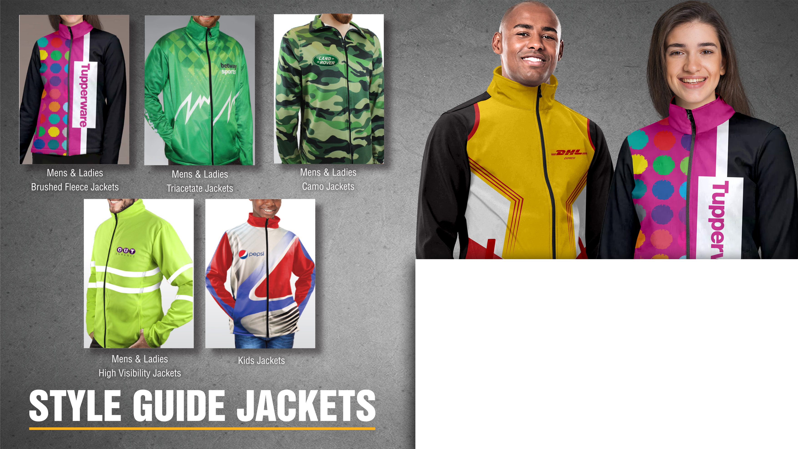
Jackets
100% Print Coverage | Stylish and comfy to notch up your athleisure style
Jackets are practical promotional products that will be used regularly by your employees and customers, creating long-lasting brand exposure.

Slide 2
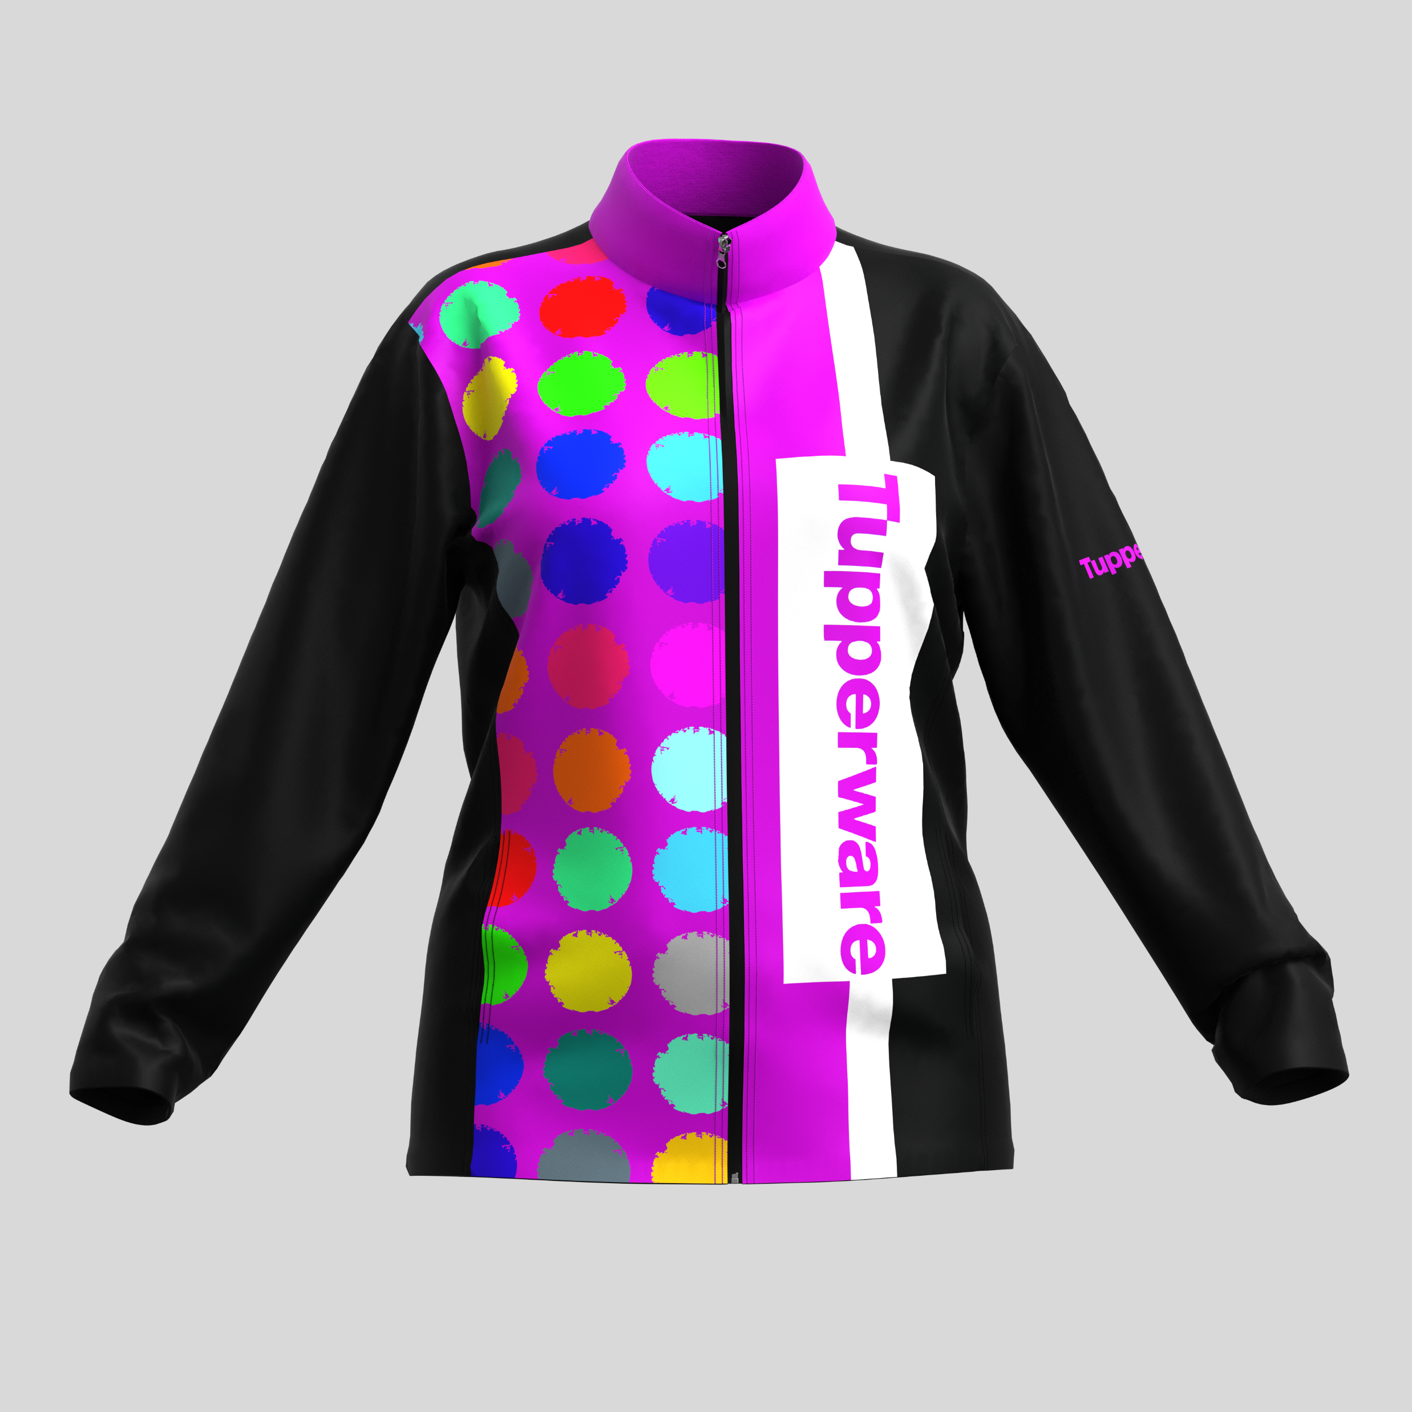

Ladies Quinn
Brushed
Fleece Jacket
Product Code :APP9036
Branding: Custom Design Full Colour Included in Price
Material: 240g/m2 brushed fleece
SIZES : S,M,L,XL,2XL,3XL,4XL,5XL
Price: R

Slide 3
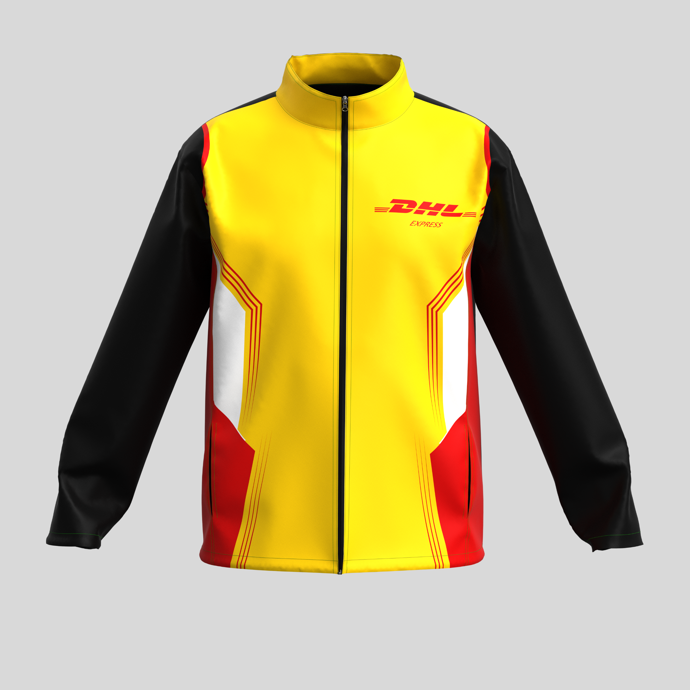
Mens Quinn
Brushed
Fleece Jacket
Product Code :APP9035
Branding: Custom Design Full Colour Included in Price
Material: 240g/m2 brushed fleece
SIZES : S,M,L,XL,2XL,3XL,4XL,5XL
Price: R

Slide 4
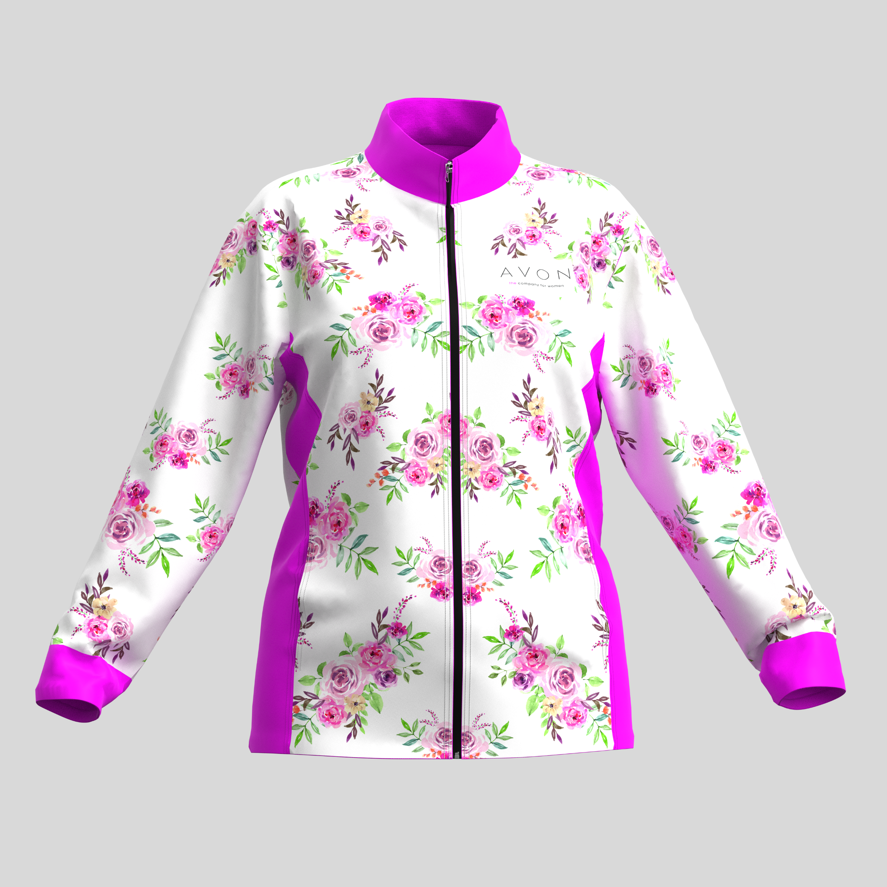
Ladies Riley
Triacetate Jacket
Product Code :APP9032
Branding: Custom Design Full Colour Included in Price
Material: 240g/m2 Polyester Triacetate
SIZES : S,M,L,XL,2XL,3XL,4XL,5XL
Price: R

Slide 5
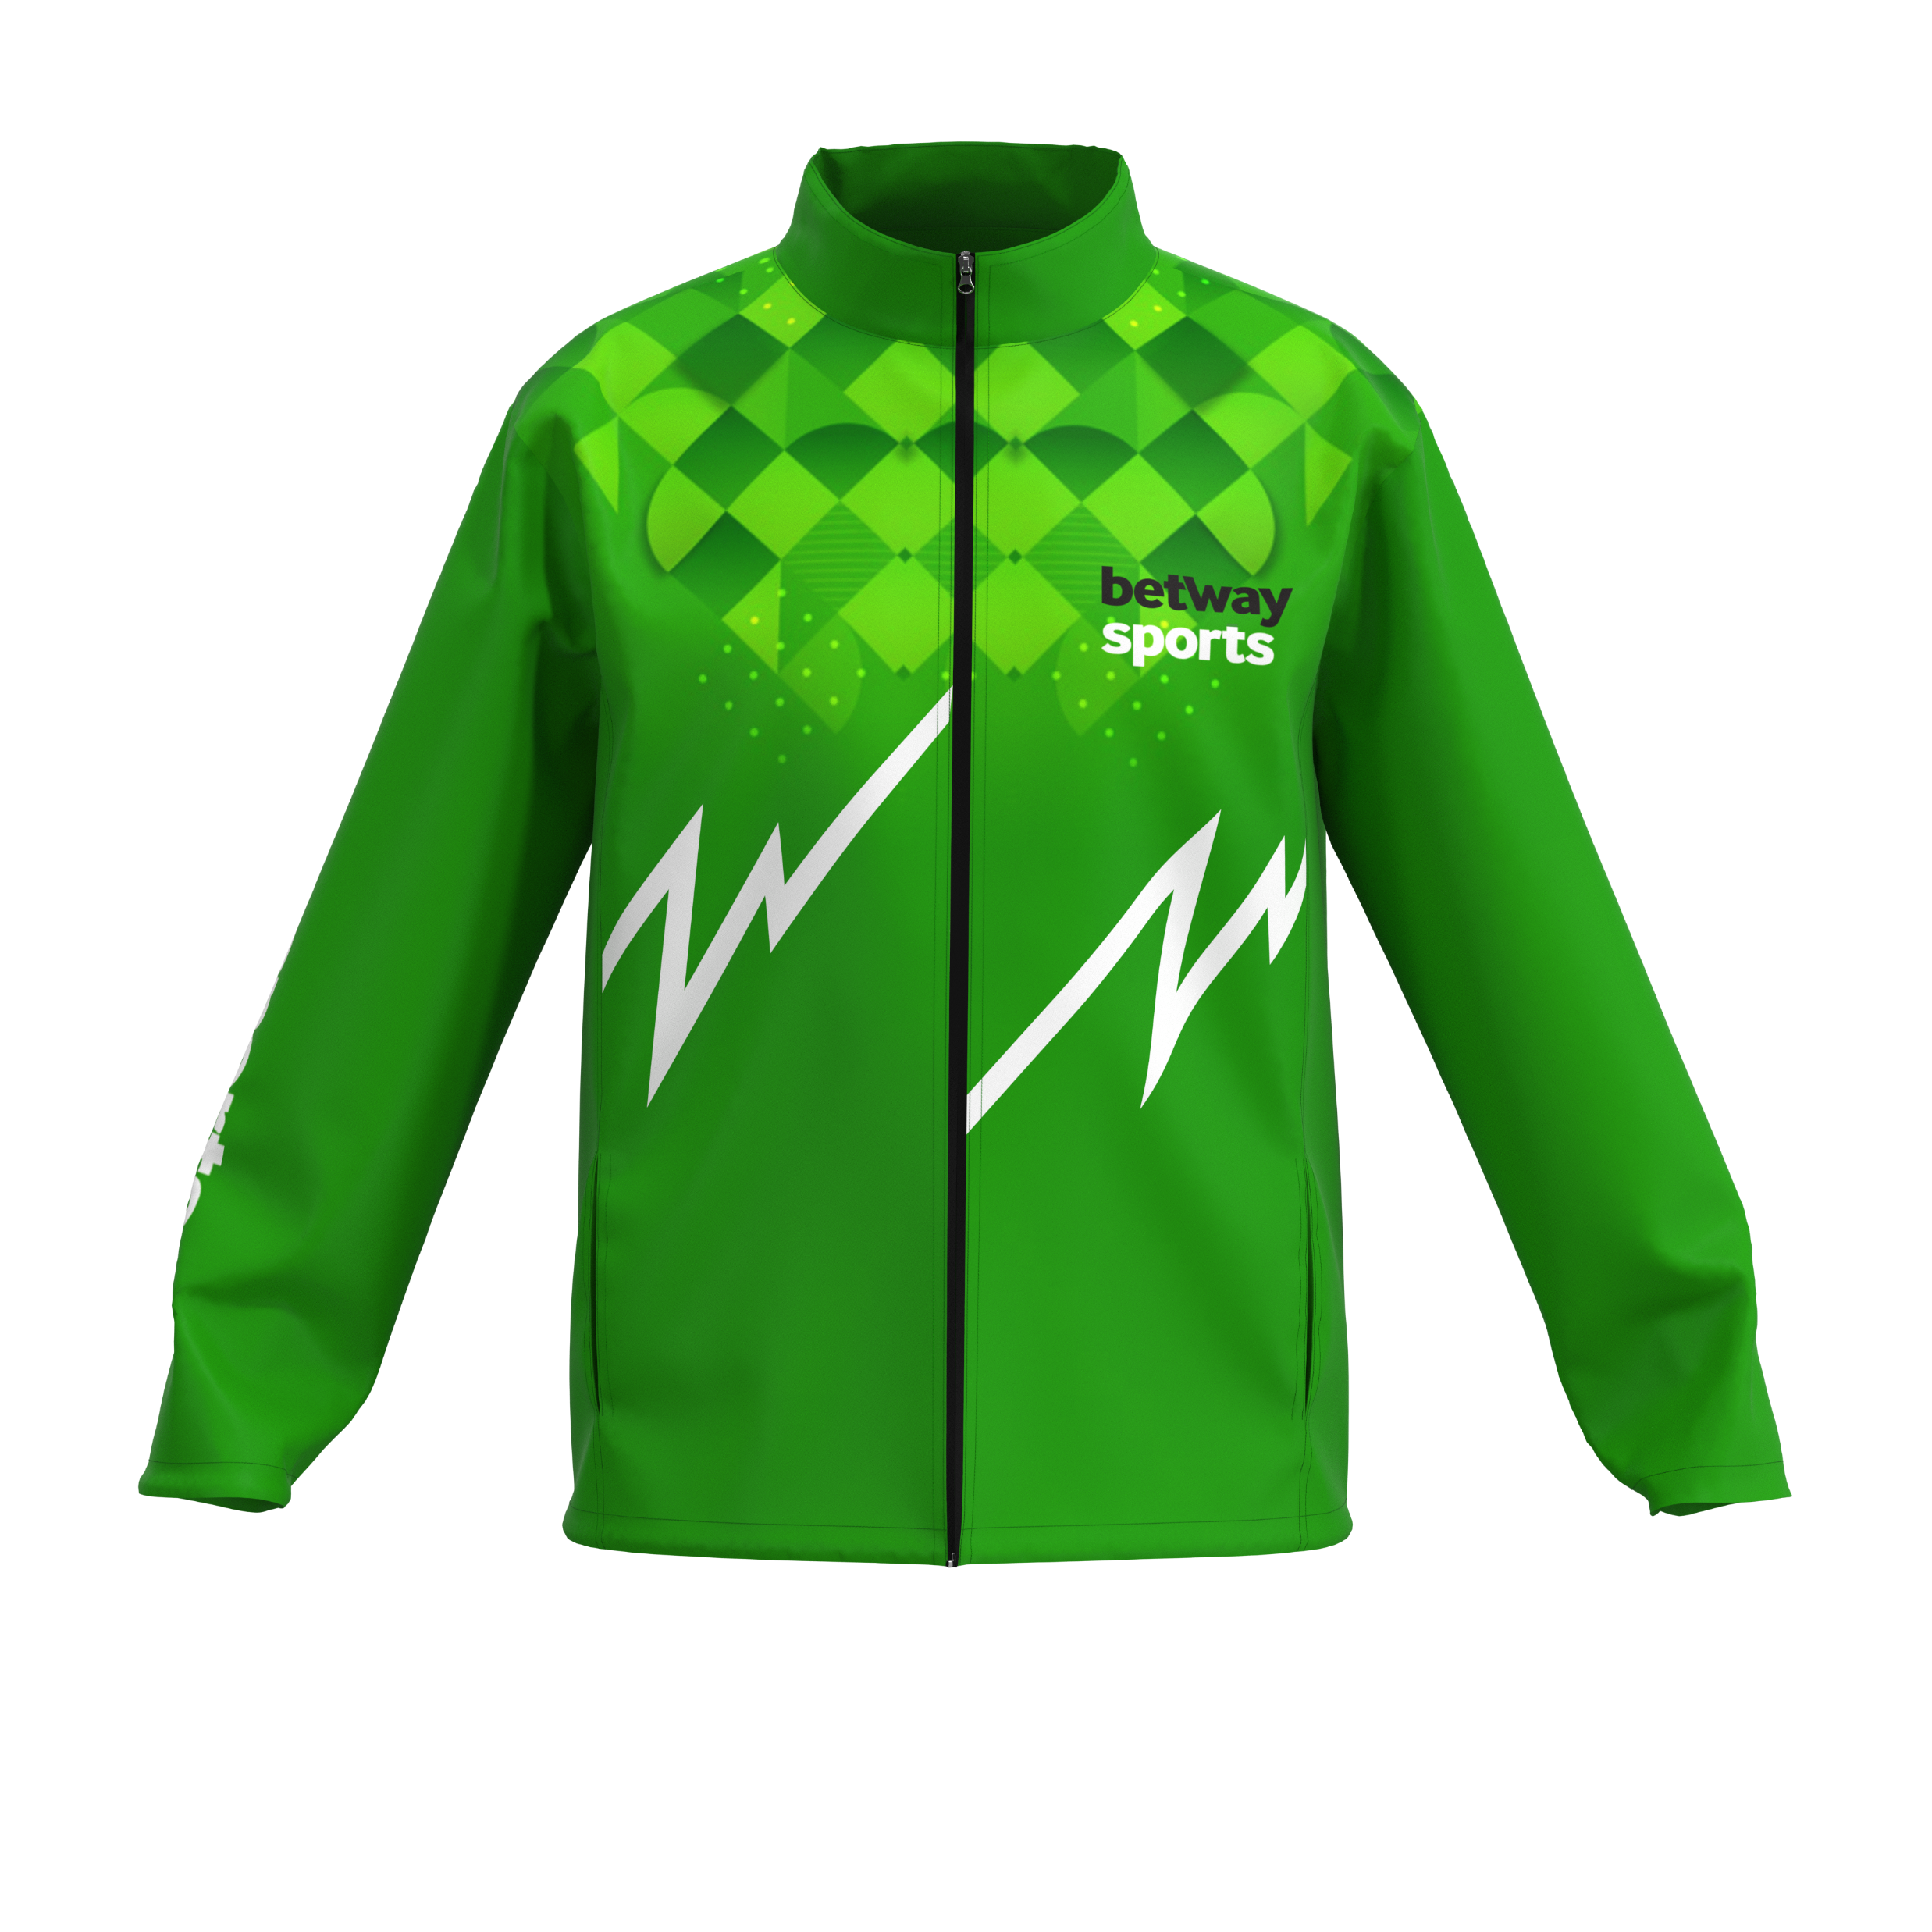
Mens Riley
Triacetate Jacket
Product Code :APP9031
Branding: Custom Design Full Colour Included in Price
Material: 240g/m2 Polyester Triacetate
SIZES : S,M,L,XL,2XL,3XL,4XL,5XL
Price: R

Slide 6
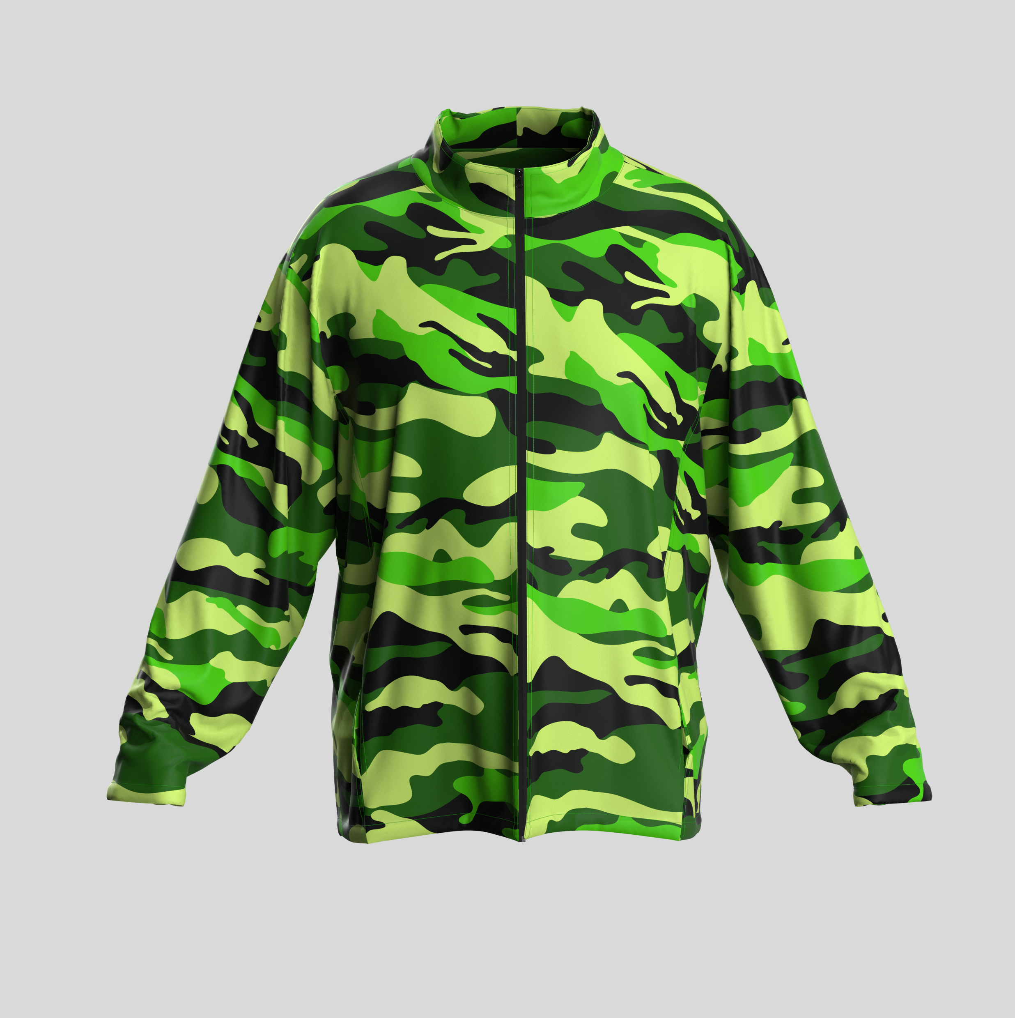
Mens Camo Brushed Fleece Jacket
Product Code :APP9033
Branding: Custom Design Full Colour Included in Price
Material: 240g/m2 Brushed Fleece
SIZES : S,M,L,XL,2XL,3XL,4XL,5XL
Price: R

Slide 7
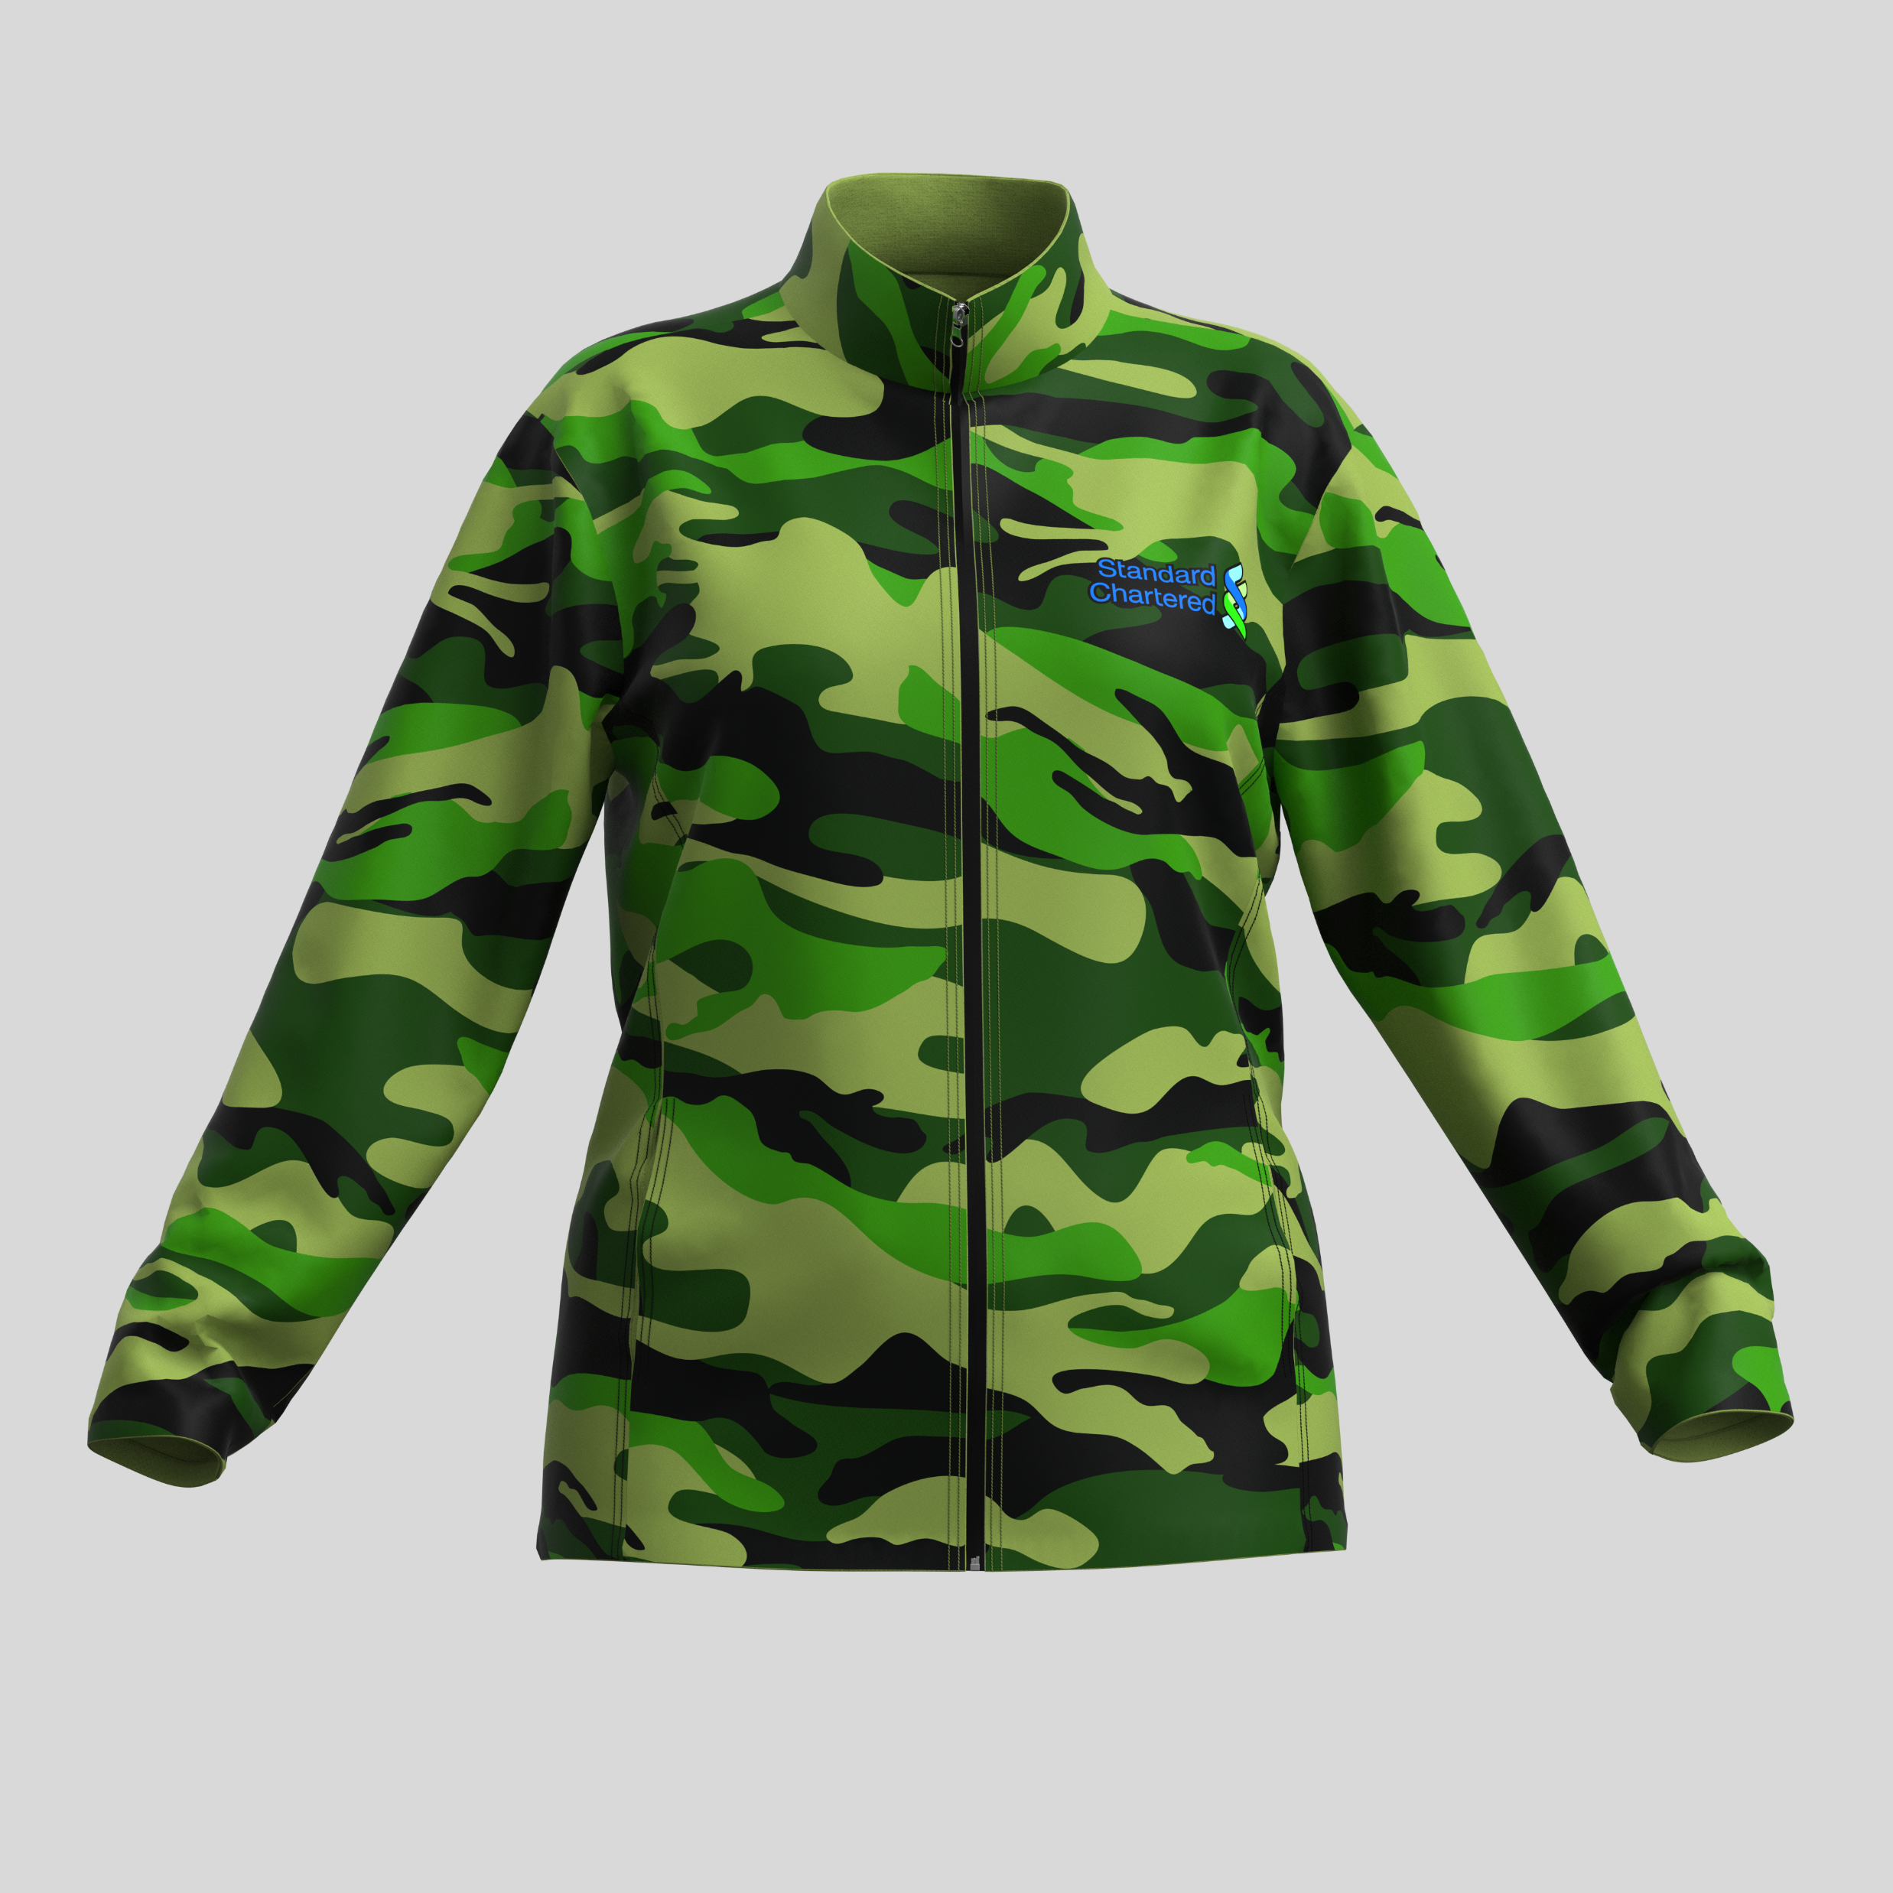
Ladies Camo Brushed Fleece Jacket
Product Code :APP9062
Branding: Custom Design Full Colour Included in Price
Material: 240g/m2 Brushed Fleece
SIZES : S,M,L,XL,2XL,3XL,4XL,5XL
Price: R

Slide 8
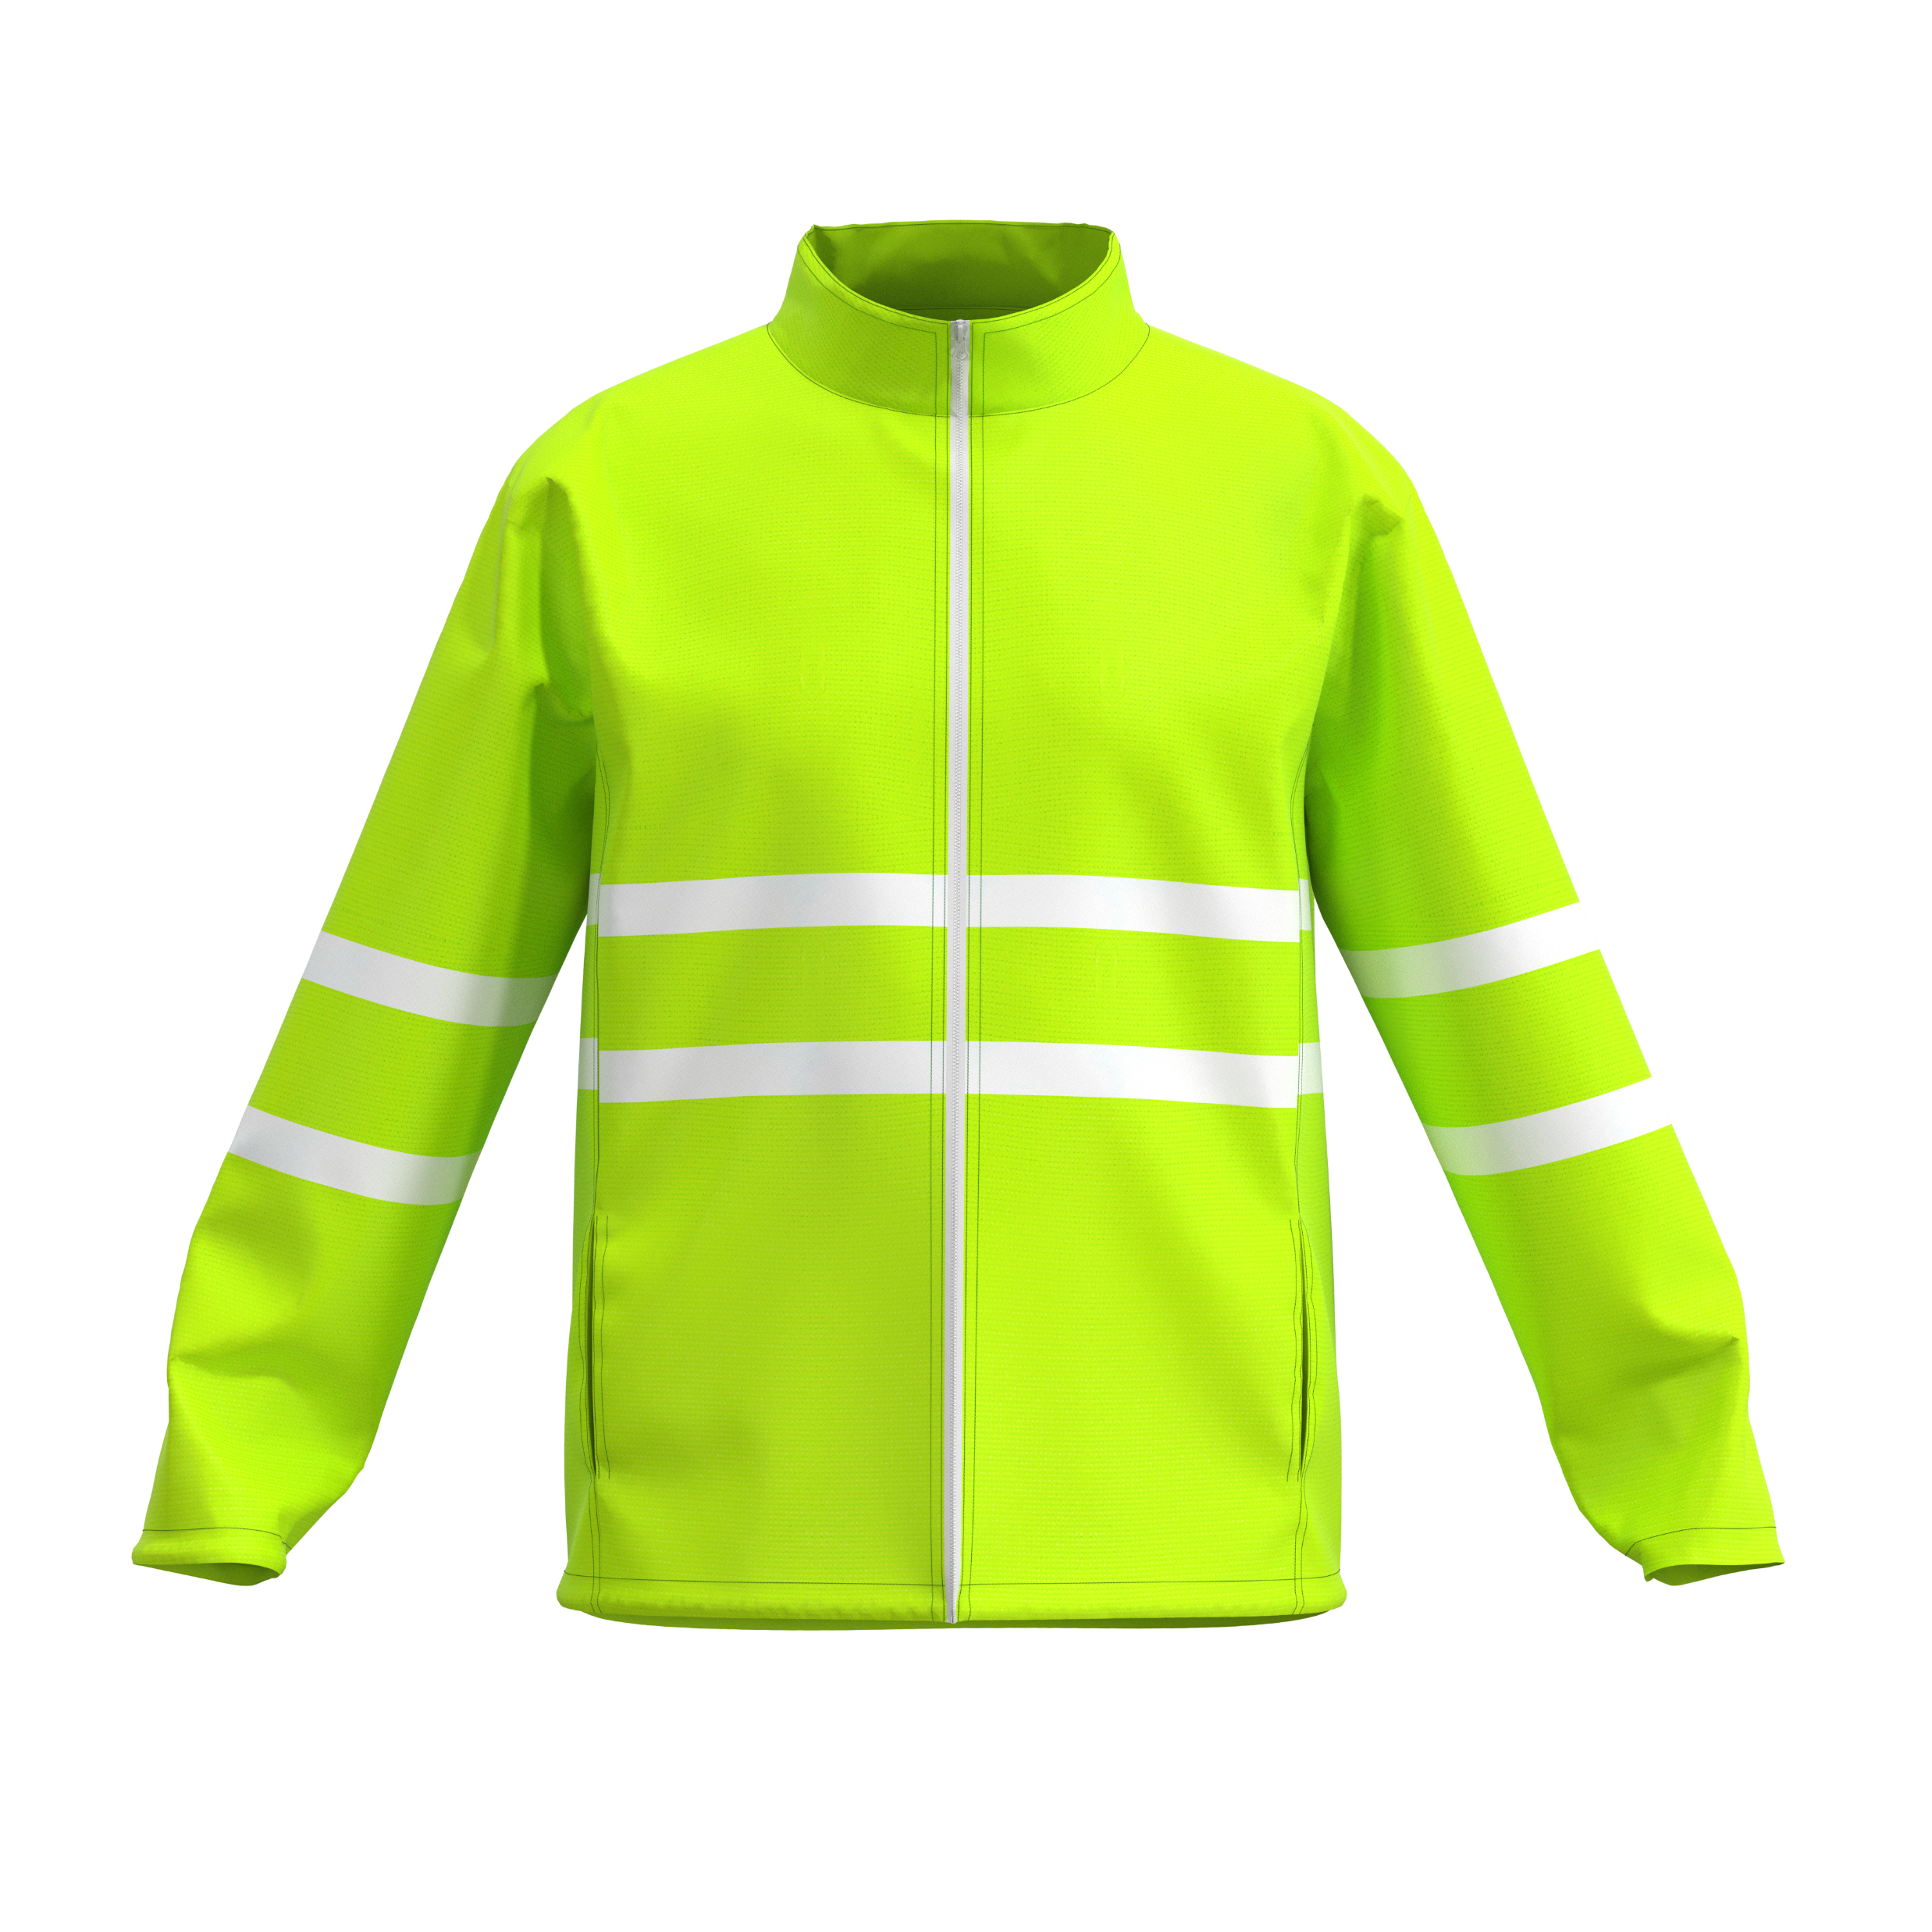
Mens High Visibility Jacket
Product Code : APP9063
Branding: Custom Design Full Colour Included in Price
Material: 145g/m2 100% Polyester mesh with Techno lining
SIZES : S,M,L,XL,2XL,3XL,4XL,5XL
Price: R

Slide 9
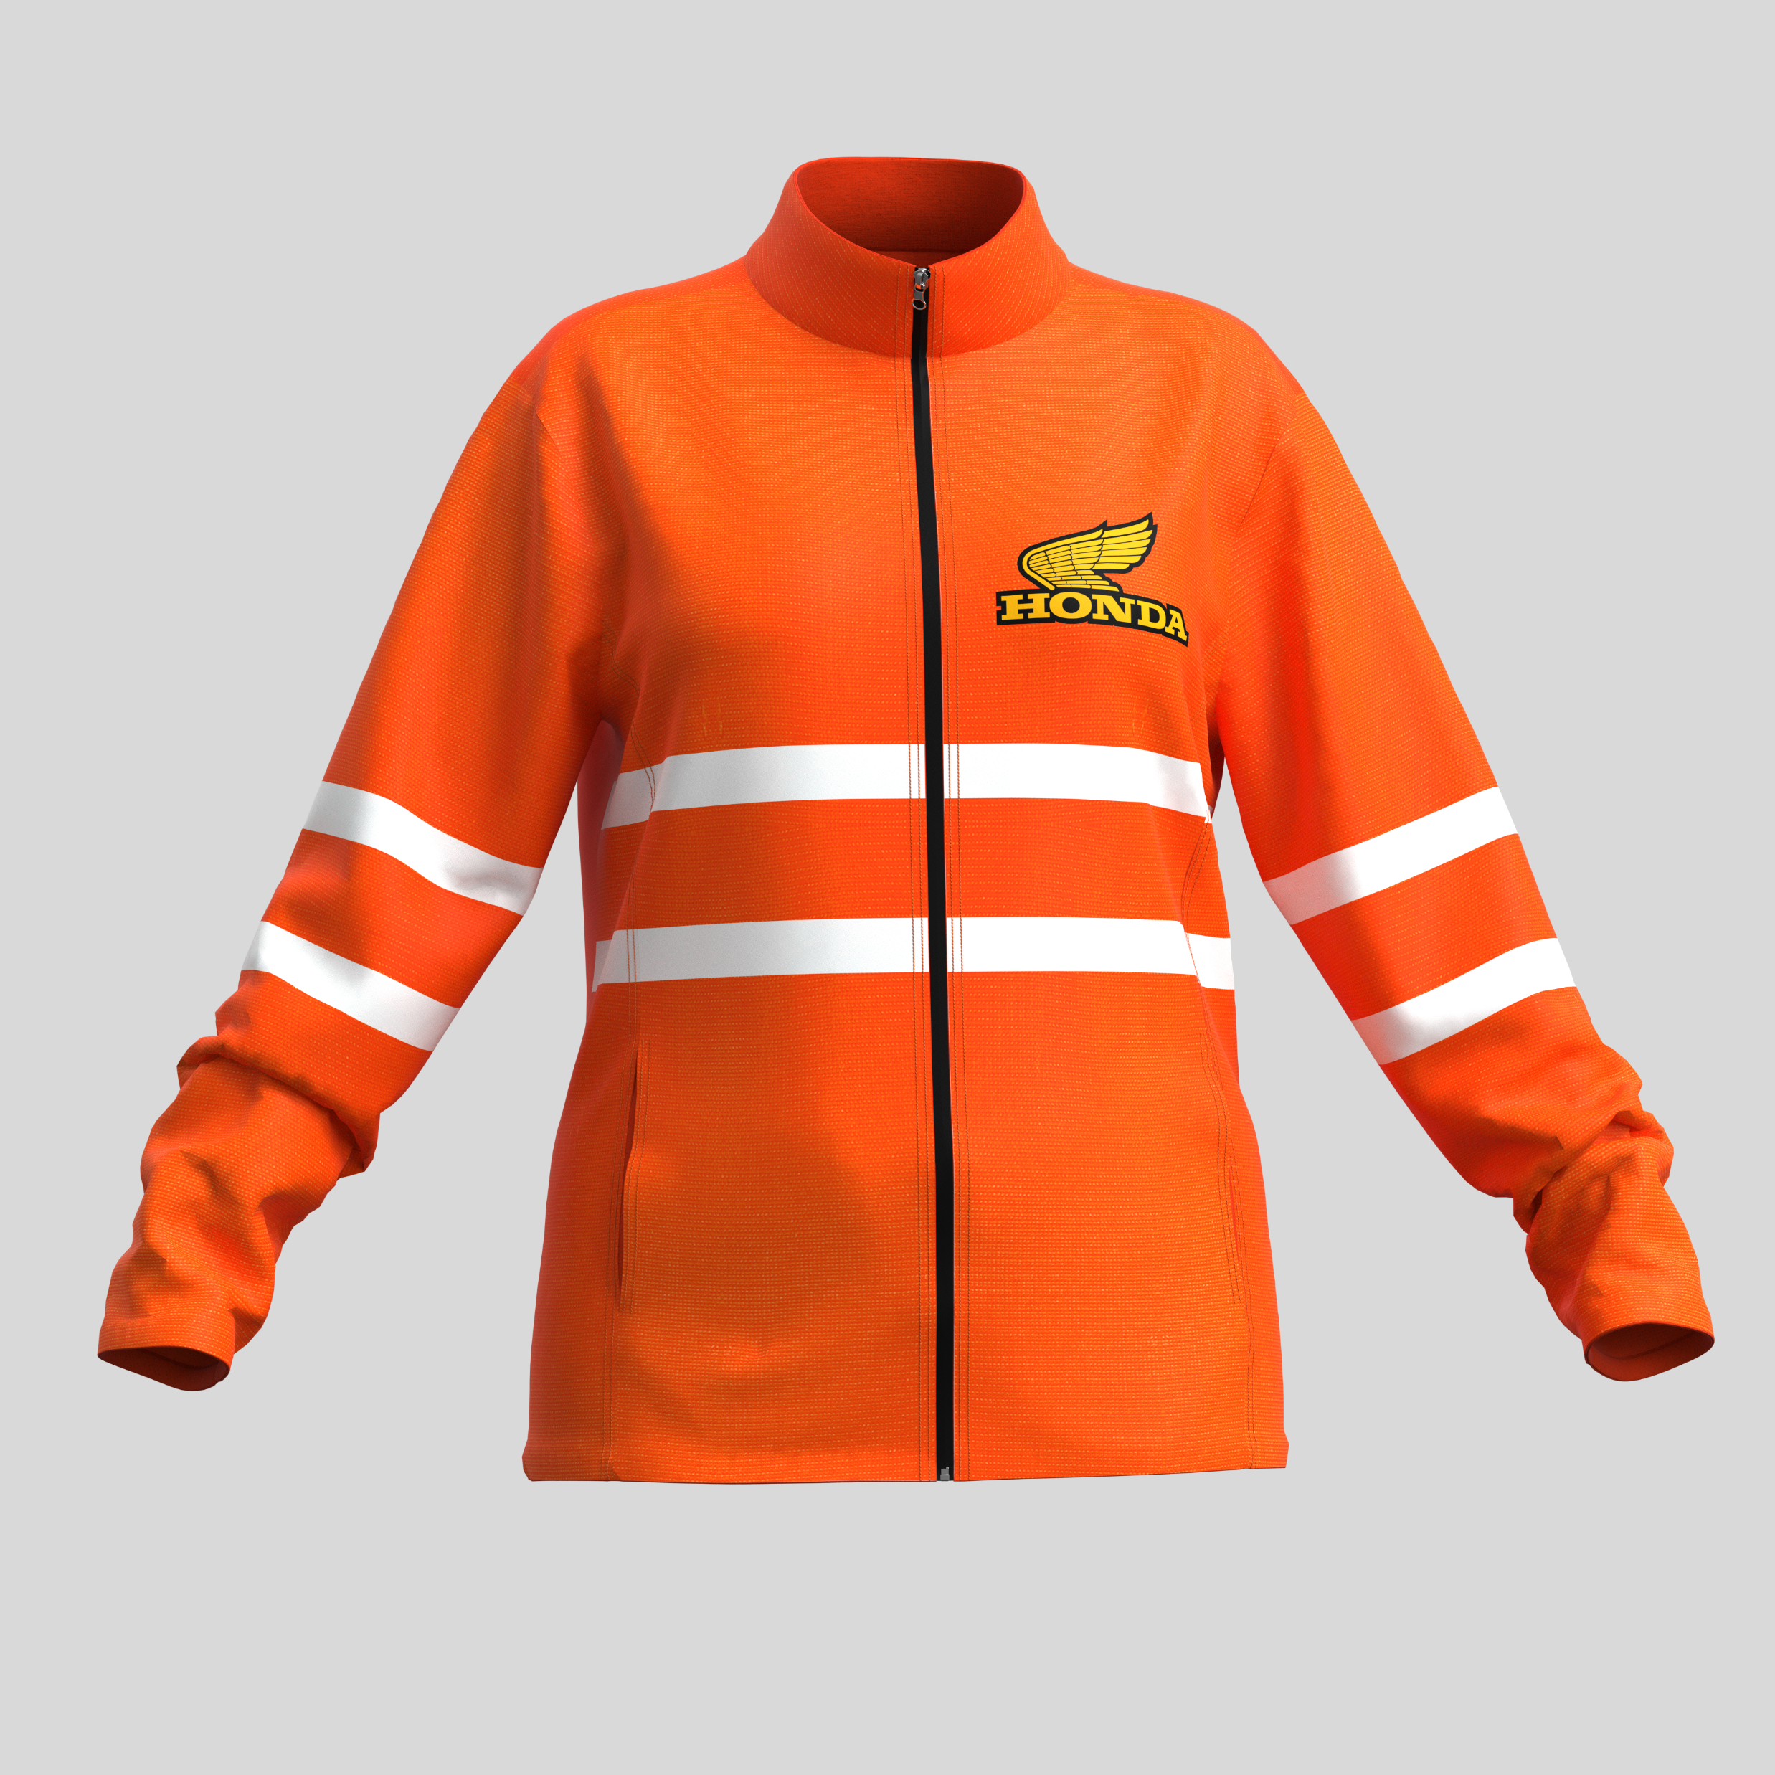
Ladies High Visibility Jacket
Product Code : APP9002
Branding: Custom Design Full Colour Included in Price
Material: 145g/m2 100% Polyester mesh with Techno lining
SIZES : S,M,L,XL,2XL,3XL,4XL,5XL
Price: R

