Slide 1


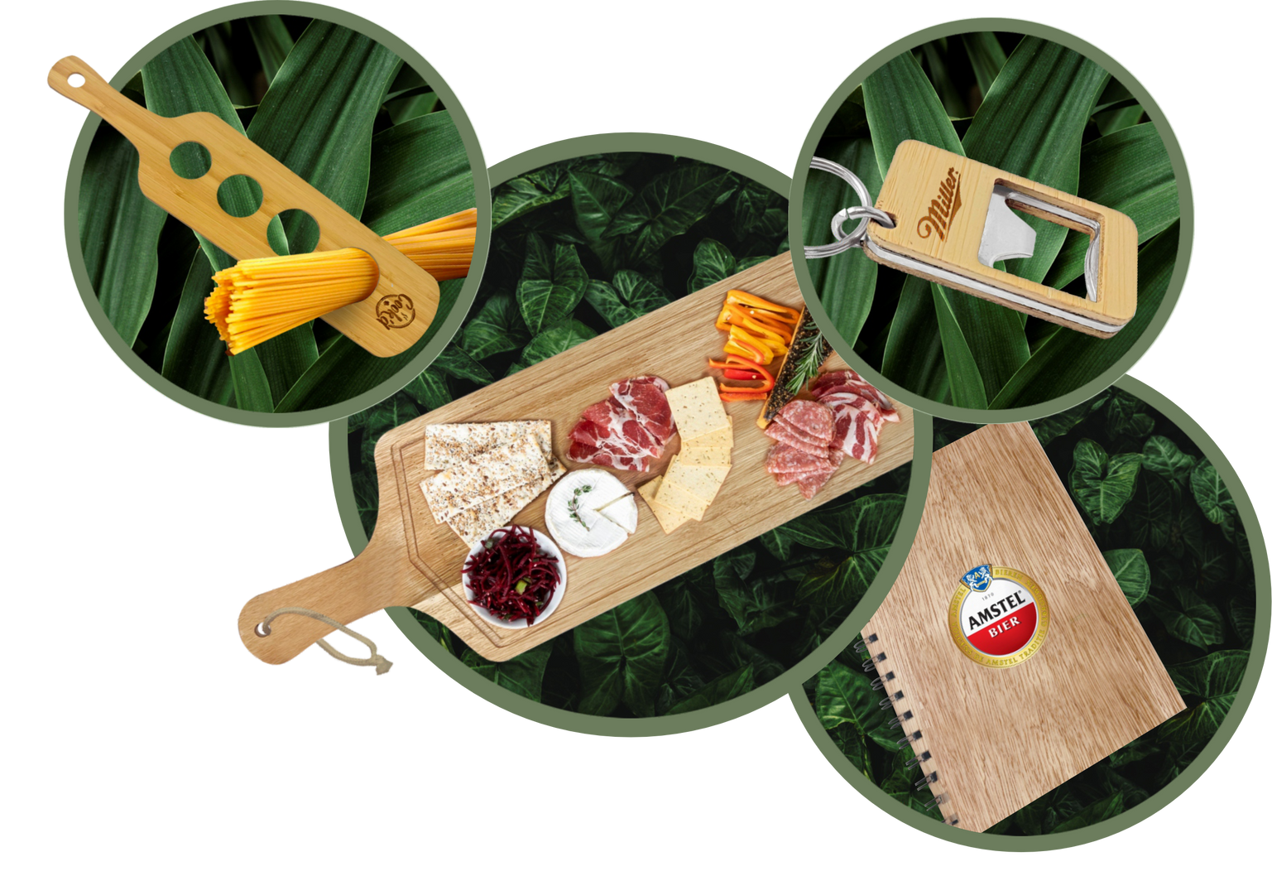


PROMOTIONAL PRODUCTS
Eco Friendly | Sustainable | Biodegradable | Durable
Promotional Gifting Guide
https://wood-products.giftsa.co.za/

Slide 2
In the competitive world, companies are to stand out from the crowd. With the growing emphasis on sustainability and uniqueness, businesses need to find innovative and eco-friendly ways to promote their brand and the brands they represent. Custom branded wooden promotional items are a perfect solution, combining style, functionality, and environmental consciousness.
Using sustainably sourced locally grown wood, our Mpho Wood Promotional range is cut, manufactured, and branded in-house. Wooden promotional items have a higher perceived value than traditional promotional products, such as plastic pens or paper notepads thus making a lasting impression on recipients.
Mpho means ‘GIFT’ in Sesotho; a fitting name for a product range that is 100% locally produced. It is safe to say we are continously pushing boundaries in the local manufacturing space.
always looking
Eco Friendly | Sustainable | Biodegradable | Durable
https://wood-products.giftsa.co.za/

Slide 3
WHAT DOES MPHO MEAN?
Mpho means gift in Sesotho; a fitting name for a promotional gifting range that is 100% locally produced. The wood is sourced locally, and the products are manufactured and branded in-house. The entire range is ideal to give as a gift, due to its strength, durability and unique grain character, no two are alike!
Eco Friendly | Sustainable | Biodegradable | Durable
https://wood-products.giftsa.co.za/

Slide 4

LASER ENGRAVING CAN BE DONE ON ALL THE FOOD RELATED PRODUCTS. THEN PRODUCTS IN THE OTHER CATEGORIES CAN BE PRINTED IN FULL COLOUR DDT (DIRECT DIGITAL TRANSFER). THE LASER ENGRAVING PROCESS CREATES A PERMANENT DESIGN THAT WILL NOT FADE OR WEAR AWAY, ENSURING THAT YOUR PROMOTIONAL ITEMS WILL STAND THE TEST OF TIME AND CONTINUE TO IMPRESS CLIENTS AND PARTNERS FOR YEARS TO COME. MAKE YOUR CLIENTS FEEL SPECIAL AS NO TWO PRODUCTS LOOK IDENTICAL DUE TO THE UNIQUE WOODGRAIN.
https://wood-products.giftsa.co.za/

Slide 5
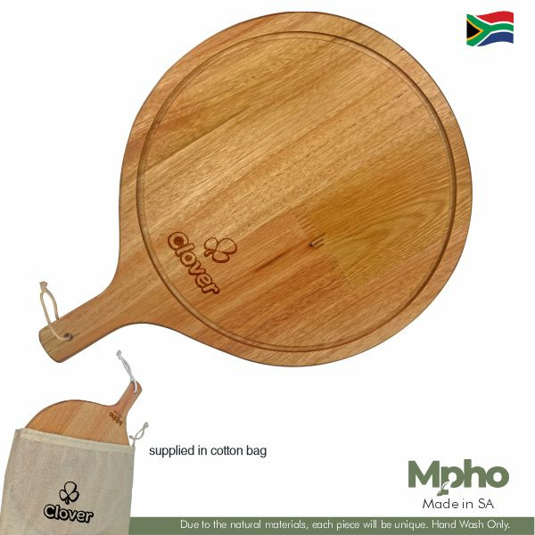

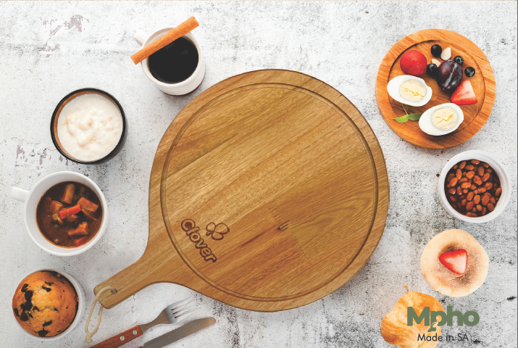
WOODEN SERVING
BOARD
BOAR052
Mpho Round Wooden Paddle Serving Board
Saligna Wood | 18mm
size | 310mm x 310mm
Supplied in cotton drawcord bag
MOQ 10 units
Selling price: R

Slide 6
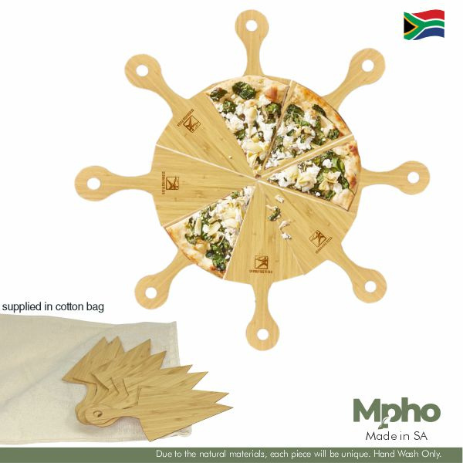
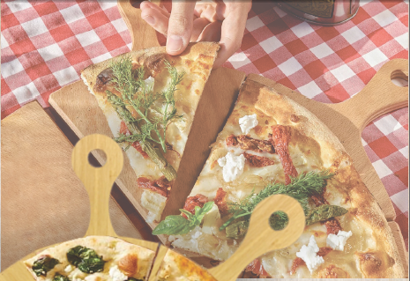
WOODEN PIZZA SLICE SERVING TRAYS
BOAR067
Mpho Pizza Slice Wooden Serving Trays
Bamboo| 3mm
size | 155mm x 120mm x 8 pieces
Supplied in cotton drawcord bag
MOQ 10 units
Selling price: R

Slide 7
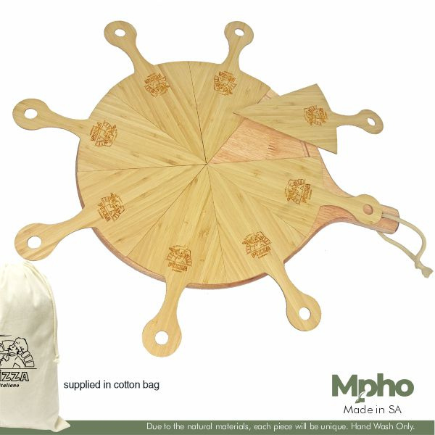
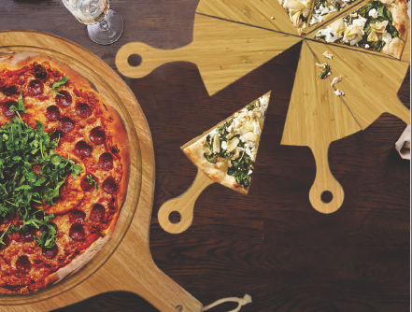
WOODEN CHARCUTERIE
PIZZA BOARD AND
SERVING TRAYS
BOAR054
Mpho Round Wooden Paddle Serving Board & Pizza Slice Servers
Saligna Wood | 18mm Bamboo | 3mm
Board Size | 310mm x 310mm
Server Size | 3mm size | 155mm x 120mm x 8 pieces
Supplied in cotton drawcord bag
MOQ 10 units
Selling price: R

Slide 8
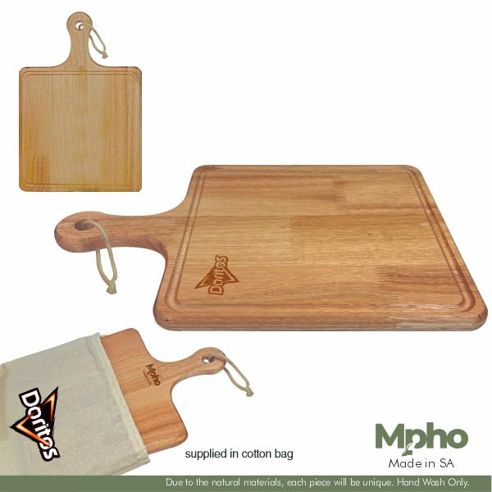
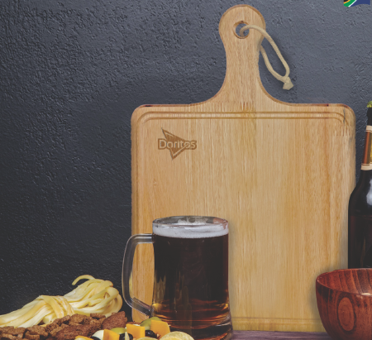
WOODEN SERVING
BOARD
BOAR055
Mpho Square Wooden Paddle Serving Board
Saligna Wood | 18mm
size | 300mm x 300mm Supplied in cotton drawcord bag
MOQ 10 units
Selling price: R

Slide 9
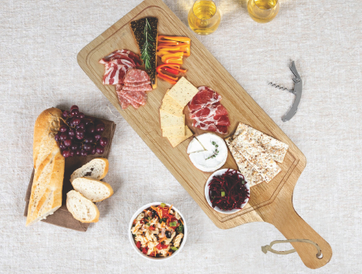
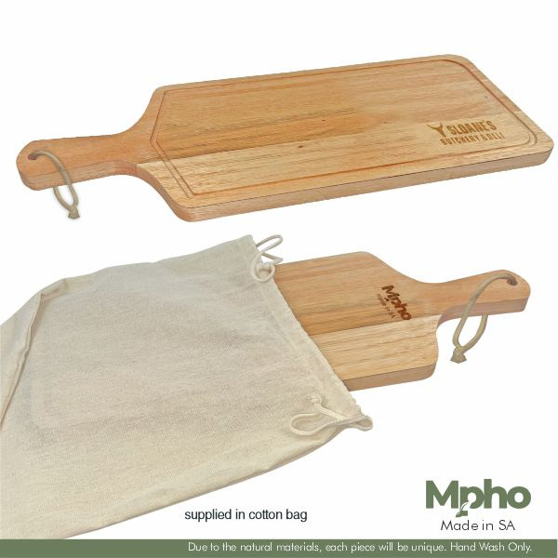
WOODEN SERVING
BOARD
BOAR056
Mpho Rectangle Wooden Paddle Serving Board
Saligna Wood | 18mm
size | 360mm x 175mm
Supplied in cotton drawcord bag
MOQ 10 units
Selling price: R

Slide 10
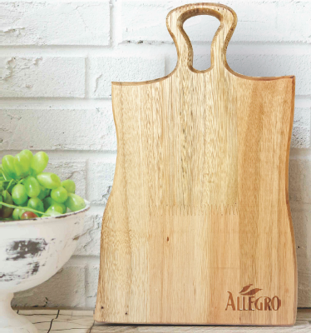
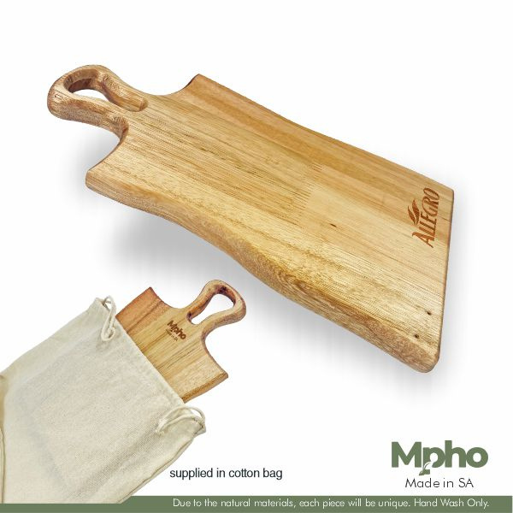
WOODEN CHEESE
BOARD
BOAR060
Mpho Wooden Shape Cheese Board
Saligna Wood | 18mm
size | 260mm x 215mm
Supplied in cotton drawcord bag
MOQ 10 units
Selling price: R

Slide 11
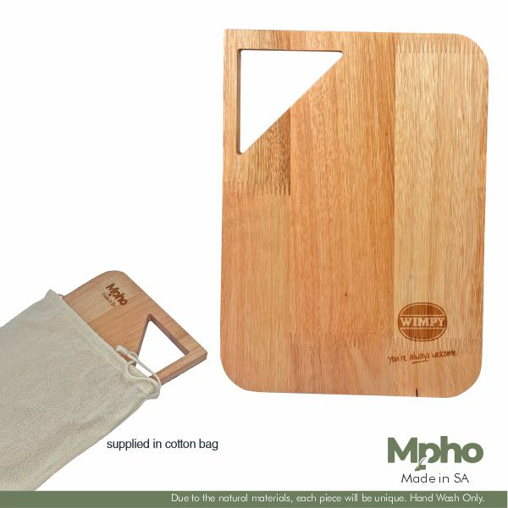
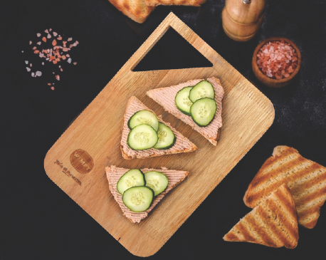
WOODEN SERVING
BOARD
BOAR064
Mpho Wooden Rectangle Serving Board with Cutout Handle
Saligna Wood | 18mm
size | 330mm x 240mm Supplied in cotton drawcord bag

Slide 12
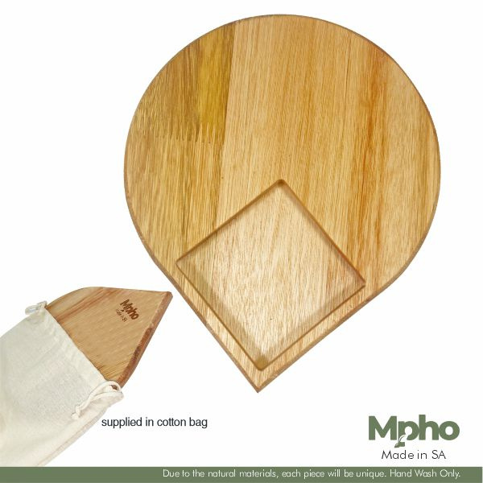
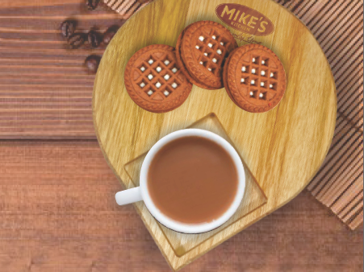
WOODEN MINI
SERVING TRAY
BOAR066
Mpho Round Wooden Mini Serving Tray
Saligna Wood | 18mm
size | 200mm x 200mm
Supplied in cotton drawcord bag
MOQ 10 units
Selling price: R

Slide 13
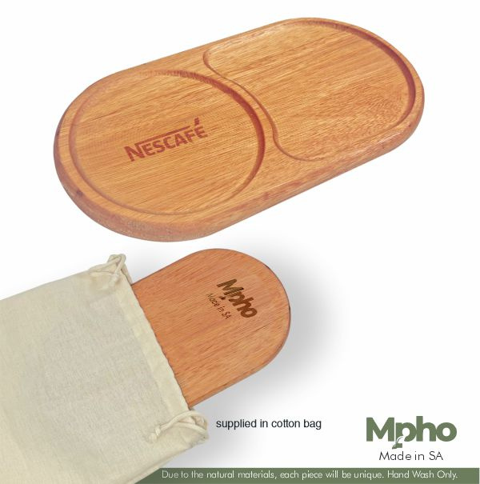
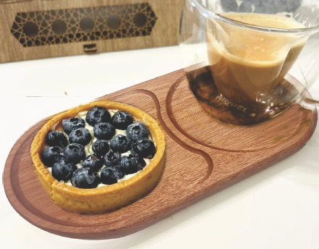
WOODEN MINI
SERVING TRAY
BOAR062
Mpho Wooden Tea & Biscuit Tray
Saligna Wood | 18mm
size | 270mm x 140mm
Supplied in cotton drawcord bag
MOQ 10 units
Selling price: R

Slide 14
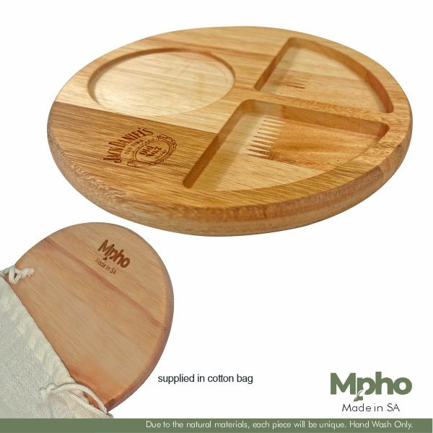
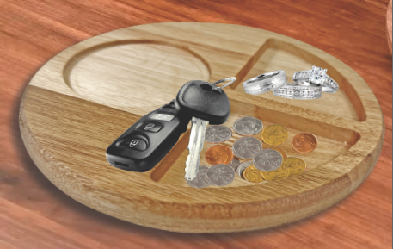
WOODEN MINI
SERVING
TRAY
BOAR059
Mpho Round Wooden Glass & Snack Tray
Saligna Wood | 18mm
size | 200mm x 200mm
Supplied in cotton drawcord bag
MOQ 10 units
Selling price: R

Slide 15
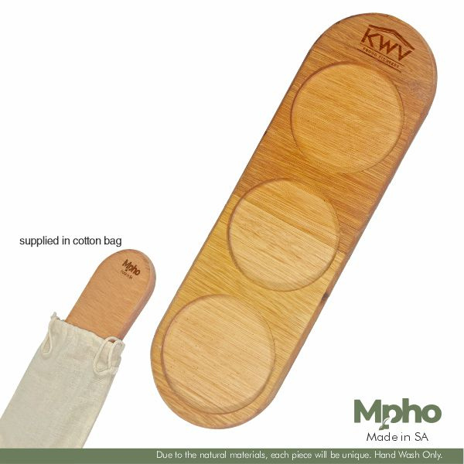
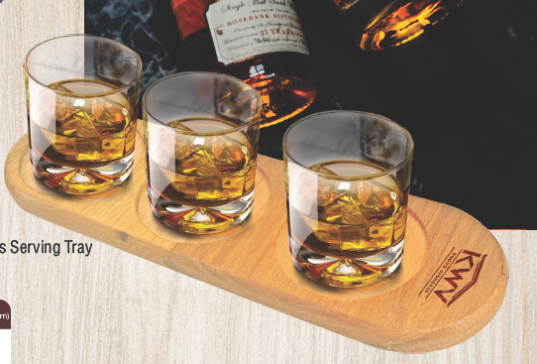
WOODEN GLASS
SERVING TRAY
BOAR065
Mpho Wooden Glass Serving Tray
Saligna | 18mm
size | 325mm x 100mm
Supplied in cotton drawcord bag
MOQ 10 units
Selling price: R

Slide 16
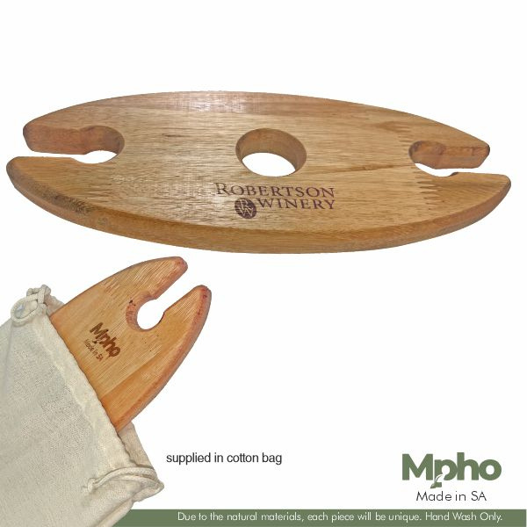
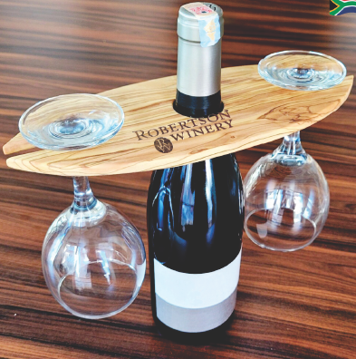
WOODEN BOTTLE &
GLASS HOLDER
BOAR063
Mpho Wooden Bottle & Wine Glass Holder
Saligna | 18mm
size | 295mm x 125mm
Supplied in cotton drawcord bag
MOQ 10 units
Selling price: R

Slide 17
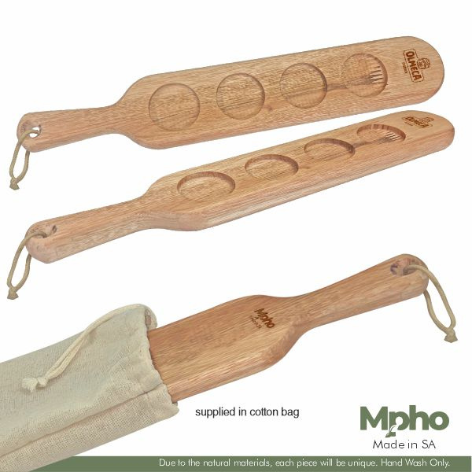
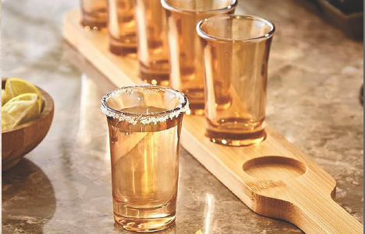
WOODEN SHOT GLASS SERVING BOARD
BOAR058
Mpho Wooden Shot Glass Holder
Saligna | 18mm
size | 395mm x 70mm
Supplied in cotton drawcord bag
MOQ 10 units
Selling price: R

Slide 18
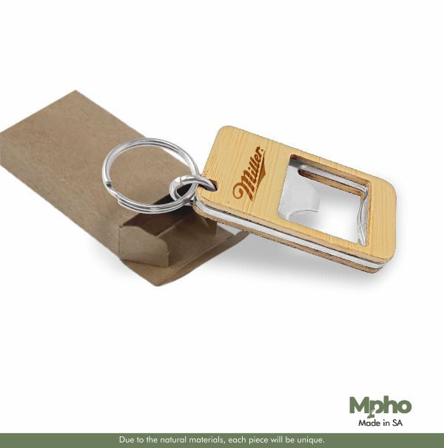
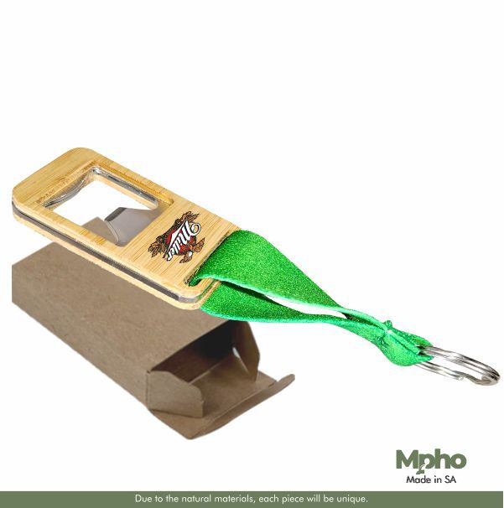
WOODEN BOTTLE OPENER KEY HOLDERS
BOAR047
Mpho Wooden Bottle Opener Key Holder
Wood | 7mm
size | 30mm x 55mm
Supplied in Kraft Box
MOQ 100 units
Selling price: R
BOAR046
Mpho Wooden Tape Bottle Opener & Sublimated Tape
Wood | 7mm
size | 30mm x 130mm
Supplied in Kraft Box
MOQ 10 units
Selling price: R

Slide 19
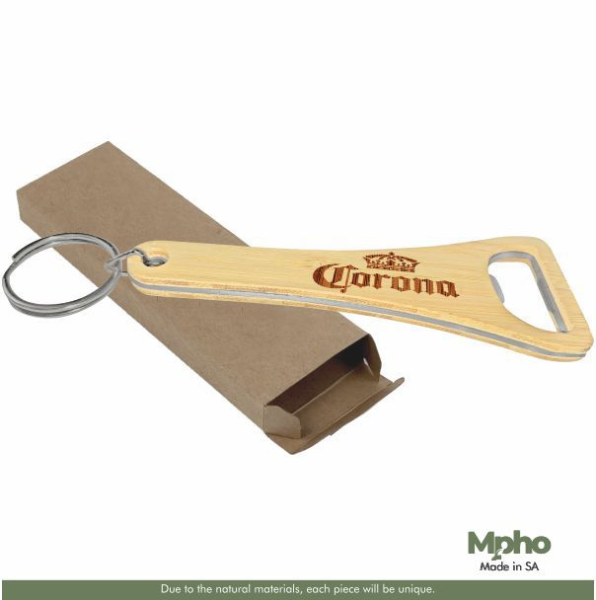
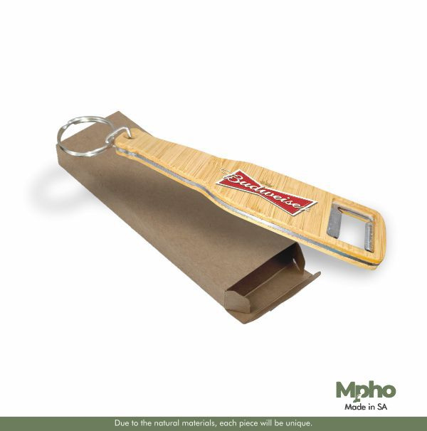
WOODEN BOTTLE OPENER
KEY HOLDERS
BOAR035
Mpho Wooden Midori Bottle Opener
Wood | 7mm
size | 115mm x 40mm
Supplied in Kraft Box
MOQ 100 units
Selling price: R
BOAR036
Mpho Wooden Manhattan Bottle
Wood | 7mm
size | 155mm x 40mm
Supplied in Kraft Box
MOQ 100 units
Selling price: R

Slide 20
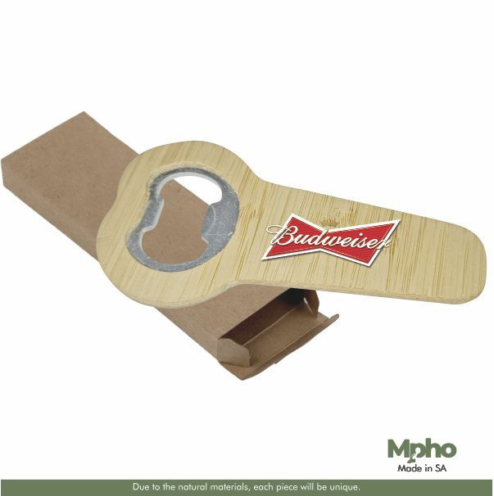
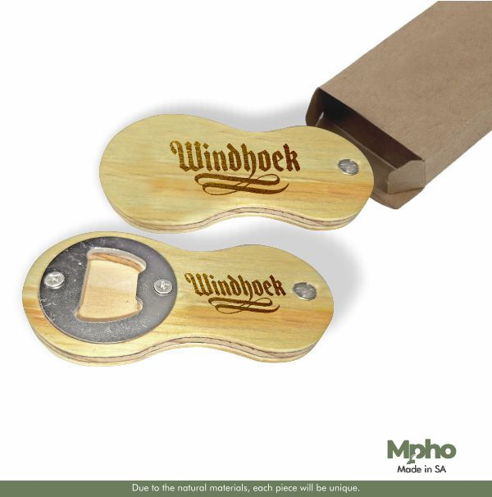
WOODEN BOTTLE OPENERS
BOAR044
Mpho Wooden T Bottle Opener
Wood & Metal | 7mm
size | 45mm x 90mm
Supplied in Kraft Box
MOQ 100 units
Selling price: R
BOAR043
Mpho Wooden Figure Bottle Opener
Wood & Metal | 7mm
size | 45mm x 90mm
Supplied in Kraft Box
MOQ 100 units
Selling price: R

Slide 21
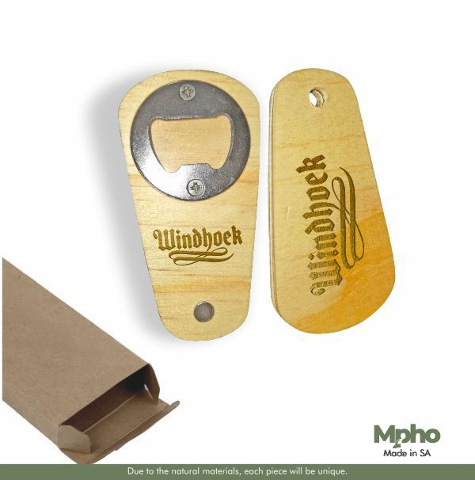
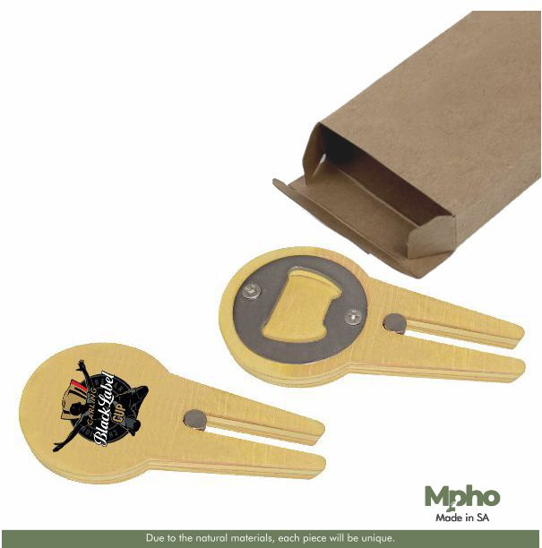
WOODEN BOTTLE OPENERS
BOAR045
Mpho Wooden Tound T Bottle Opener
Wood & Metal | 7mm
size | 45mm x 90mm
Supplied in Kraft Box
MOQ 100 units Selling price: R
BOAR040
Mpho Wooden Bottle Opener
Wood & Metal | 8mm
size | 45mm x 90mm
Supplied in Kraft Box
MOQ 100 units Selling price: R

Slide 22
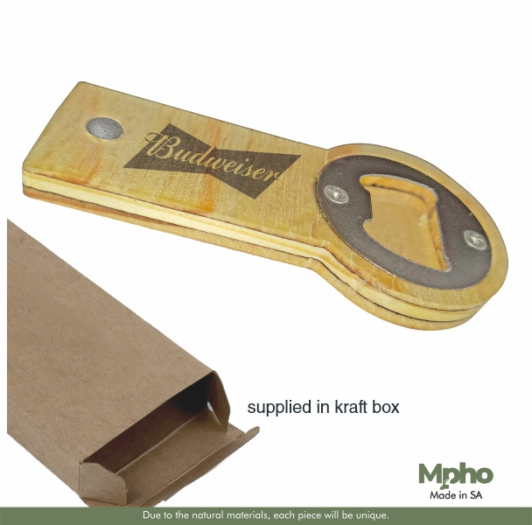
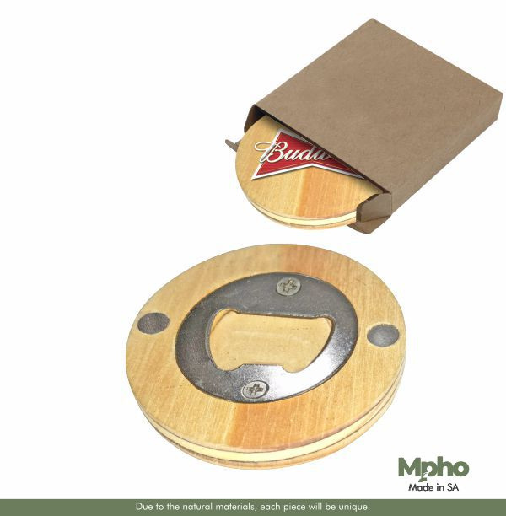
WOODEN BOTTLE OPENERS
BOAR045
Mpho Wooden Tound T Bottle Opener
Wood & Metal | 7mm
size | 45mm x 90mm
Supplied in Kraft Box
MOQ 100 units Selling price: R
BOAR042
Mpho Pop Bottle Opener
Wood & Metal | 8mm
size | 42mm x 95mm
Supplied in Kraft Box
MOQ 10 units Selling price: R

Slide 23
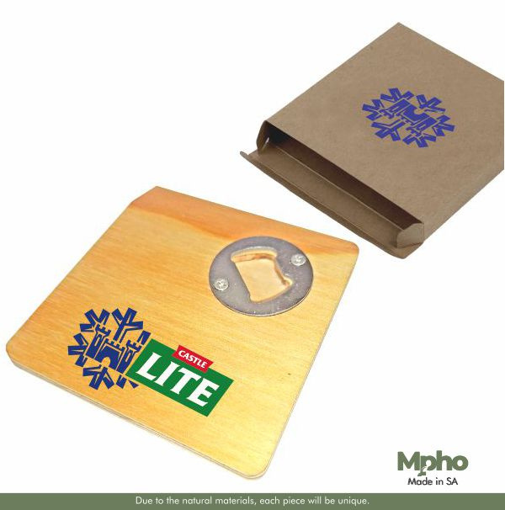
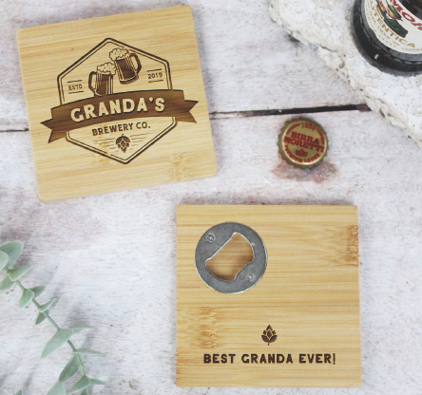
WOODEN COASTERS
BOAR041
Mpho Wooden Coaster Bottle Opener
Wood & Metal | 7mm
size | 100mm x 100mm
Supplied in Kraft Box
MOQ 100 units
Selling price: R

Slide 24
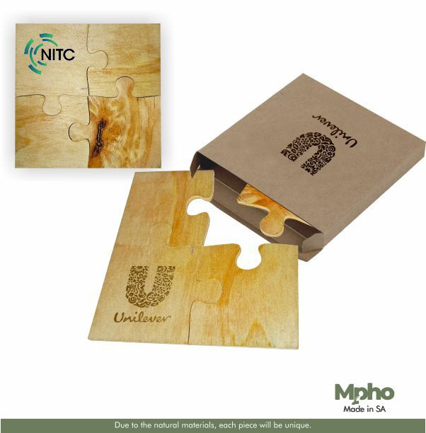

WOODEN COASTERS
BOAR033
Mpho Wooden Puzzle Coaster
Wood l | 4mm
size | 100mm x 100mm
Supplied in Kraft Box
MOQ 100 units
Selling price: R

Slide 25

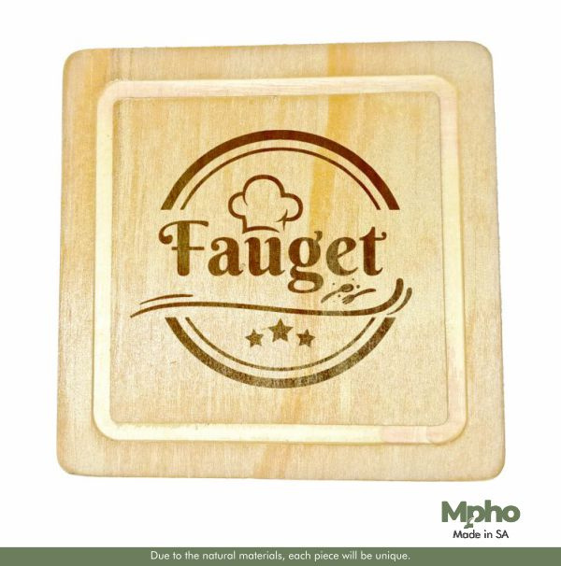
WOODEN COASTERS WITH DEBOSSED EDGES
BOAR029
Mpho Wooden Round Coaster with Debossed Edging
Wood l | 4mm
size | 90mm x 90mm
Supplied in Kraft Box
MOQ 100 units Selling price: R
BOAR029
Mpho Wooden Square Coaster with Debossed Edging
Wood l | 4mm
size | 90mm x 90mm
Supplied in Kraft Box
MOQ 10 units Selling price: R

Slide 26


WOODEN COASTERS
BOAR027
Mpho Wooden Round Coaster
Wood l | 4mm
size | 90mm x 90mm
Supplied in Kraft Box
MOQ 100 units Selling price: R
BOAR028
Mpho Wooden Square Coaster
Wood l | 4mm
size | 90mm x 90mm
Supplied in Kraft Box
MOQ 100 units Selling price: R

Slide 27
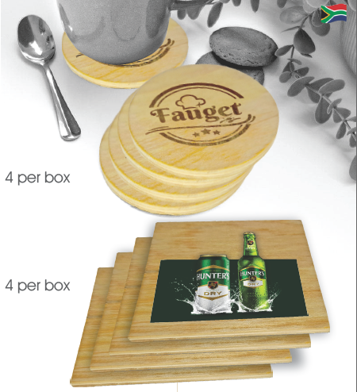
WOODEN COASTER
SETS
BOAR031
Mpho Wooden Round Coaster Set
4 Coasters per box
Wood l | 4mm
size | 90mm x 90mm
Supplied in Kraft Box
MOQ 100 units
Selling price: R
BOAR032
Mpho Wooden Square Coaster Set
4 Coasters per box
Wood l | 4mm
size | 90mm x 90mm
Supplied in Kraft Box
MOQ 100 units
Selling price: R

Slide 28
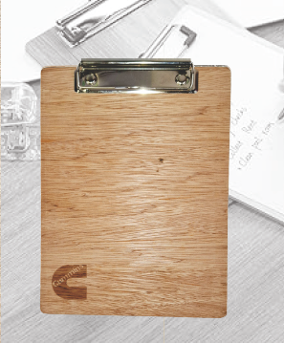
WOODEN CLIP BOARDS
BOAR022
Mpho Wooden A5 Clipboard
Wood l | 3mm
size | 155mm x 230mm
MOQ 100 units
Selling price: R
BOAR021
Mpho Wooden A4 Clipboard
Wood l | 3mm
size | 220mm x 330mm
MOQ 100 units
Selling price: R

Slide 29
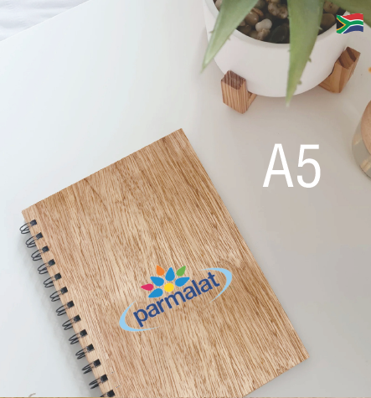
WOODEN NOTEBOOKS
BOAR023
Mpho Wooden A5 Notebook
Wood l | 3mm
size | 148mm x 210mm
MOQ 100 units
Selling price: R
BOAR024
Mpho Wooden A4 Notebook
Wood l | 3mm
size | 210mm x 297mm
MOQ 100 units
Selling price: R

Slide 30
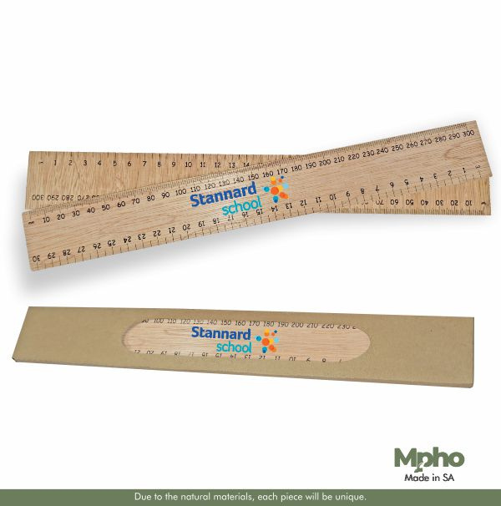
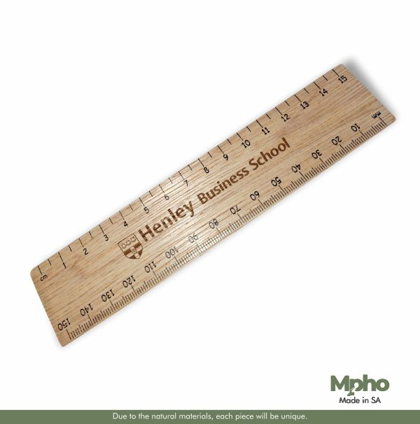
WOODEN
RULERS
BOAR050
Mpho Wooden 30cm ruler
Wood l | 3mm
size | 315mm x 45mm
MOQ 100 units
Selling price: R
BOAR051
Mpho Wooden 15cm Ruler
Wood l | 3mm
size | 130mm x 32mm
MOQ 10 units
Selling price: R

Slide 31
WOODEN RULERS
IN KRAFT BOX
BOAR026
Mpho Wooden 30cm ruler supplied
in kraft box
Wood l | 3mm
size | 315mm x 45mm
MOQ 100 units
Selling price: R

Slide 32
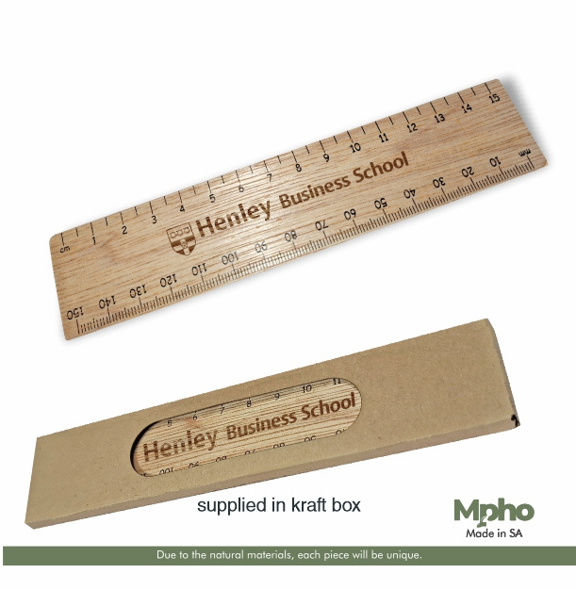
WOODEN RULERS
WITH KRAFT BOX
BOAR025
Mpho Wooden 15cm Ruler supplied in kraft box
Wood l | 3mm
size | 130mm x 32mm
MOQ 100 units
Selling price: R

Slide 33
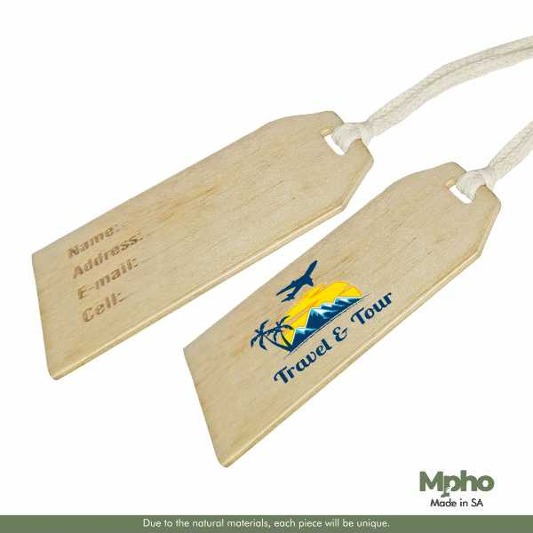
WOODEN LUGGAGE
TAGS
BOAR037
Mpho Wooden Junior Luggage Tag
Wood l | 4mm
size | 100mm x 50mm
MOQ 100 units
Selling price: R
BOAR038
Mpho Wooden Luggage Tag
Wood l | 4mm
size | 110mm x 60mm
MOQ 100 units
Selling price: R

Slide 34
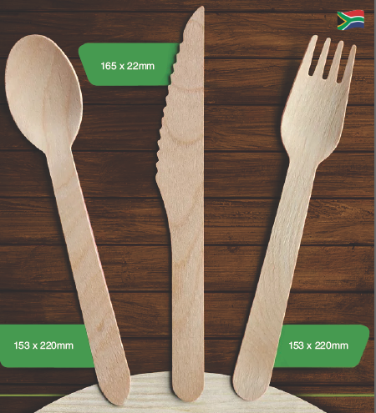
WOODEN CUTLERY SET
BOAR048
Mpho Wooden Cutlery Set
Wood |
size | Fork 153mm x 22mm
Spoon 153mm x 22mm
Knife 165mm x 22mm
Supplied in cotton drawcord bag
MOQ 100 units
Selling price: R

