Slide 1
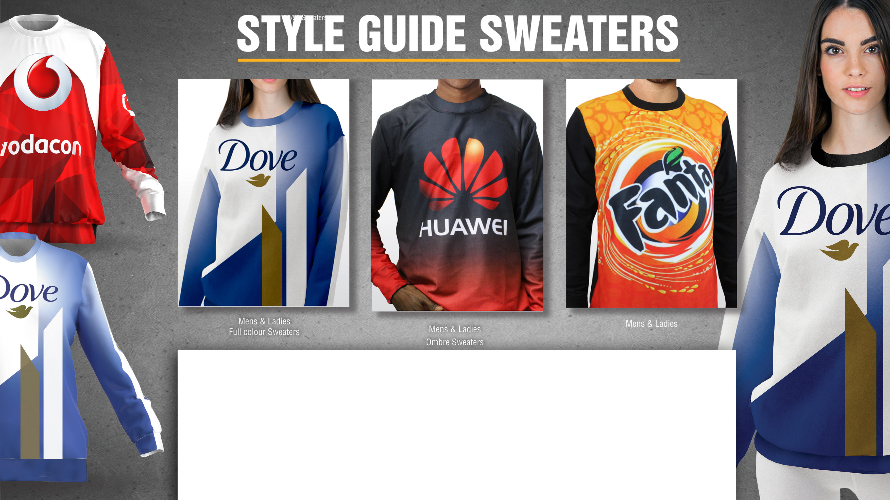
Sweaters 100% Print Coverage | Stylish and comfy to notch up your athleisure style Our branded Sweaters are made from high-quality brushed fleece material which locks your full colour design into the fabric. The quality of the sublimation printing process means that the sweaters will retain their vibrant colours through years of continued use

Slide 2
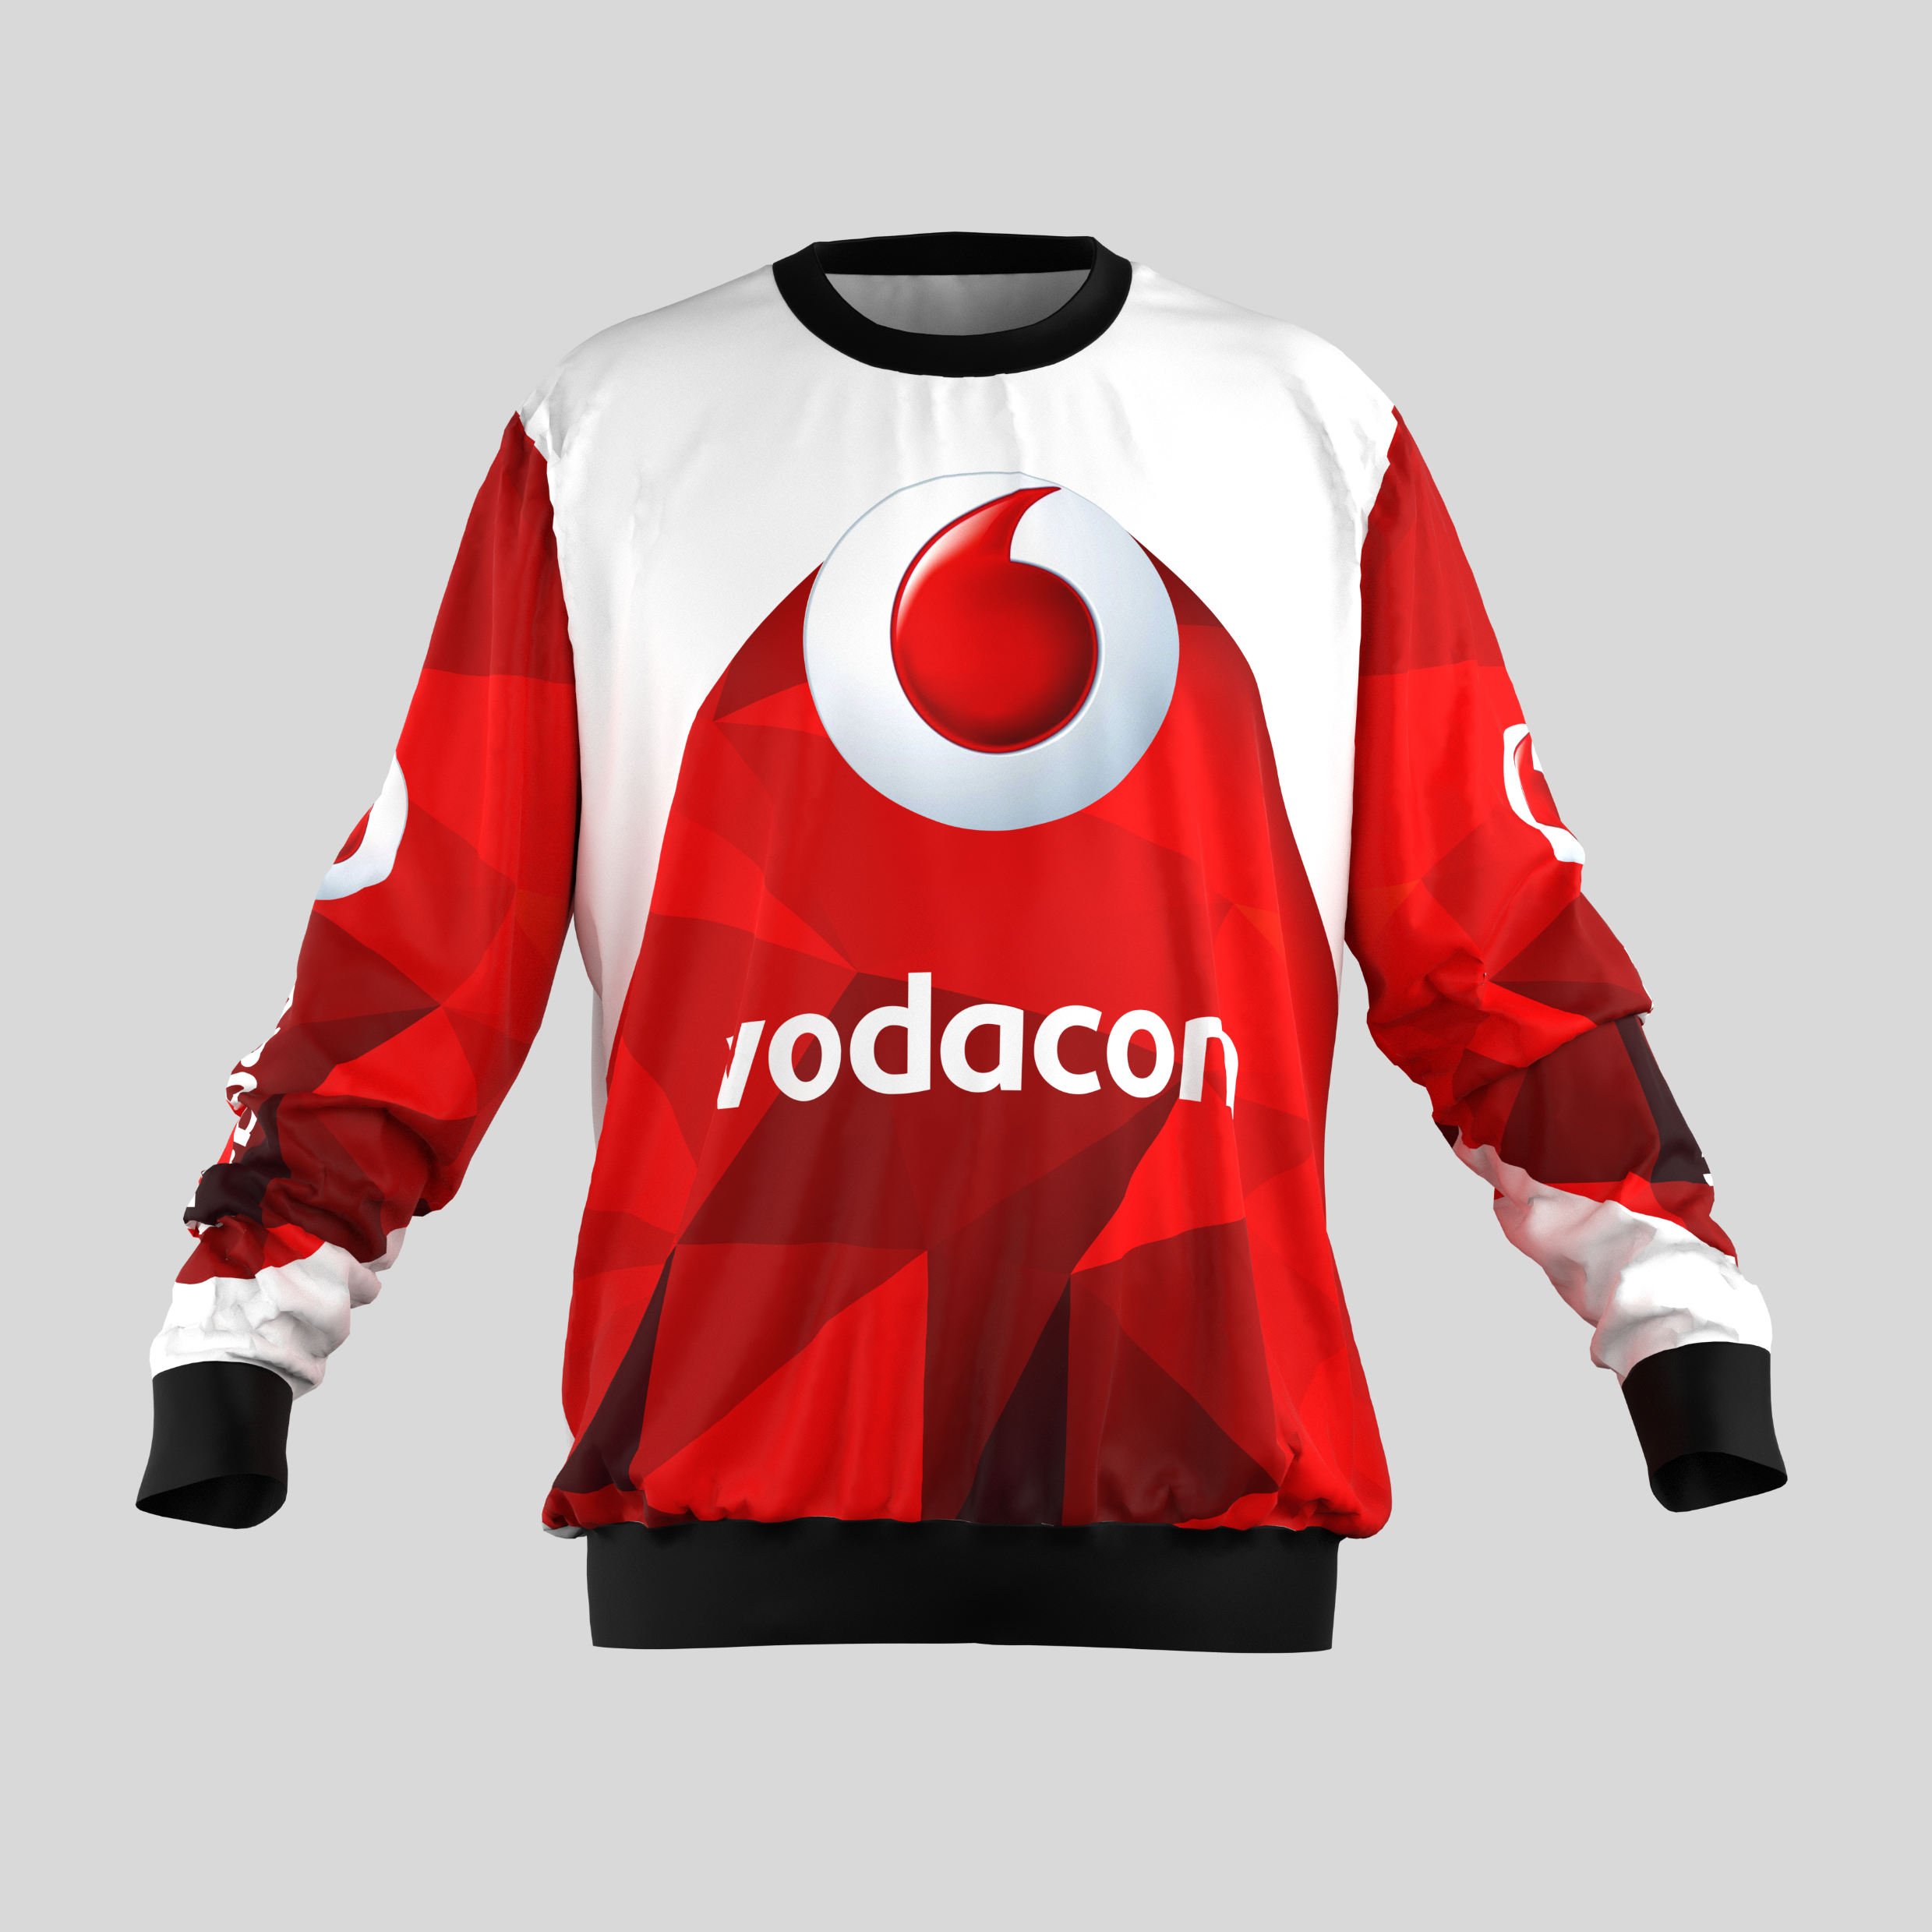

Mens Dakota Brushed Fleece Sweater
Product Code : APP9025
Branding: Custom Design Full Colour Included in Price
Material: 240g/m2 brushed fleece
SIZES : S,M,L,XL,2XL,3XL,4XL,5XL
Price: R

Slide 3
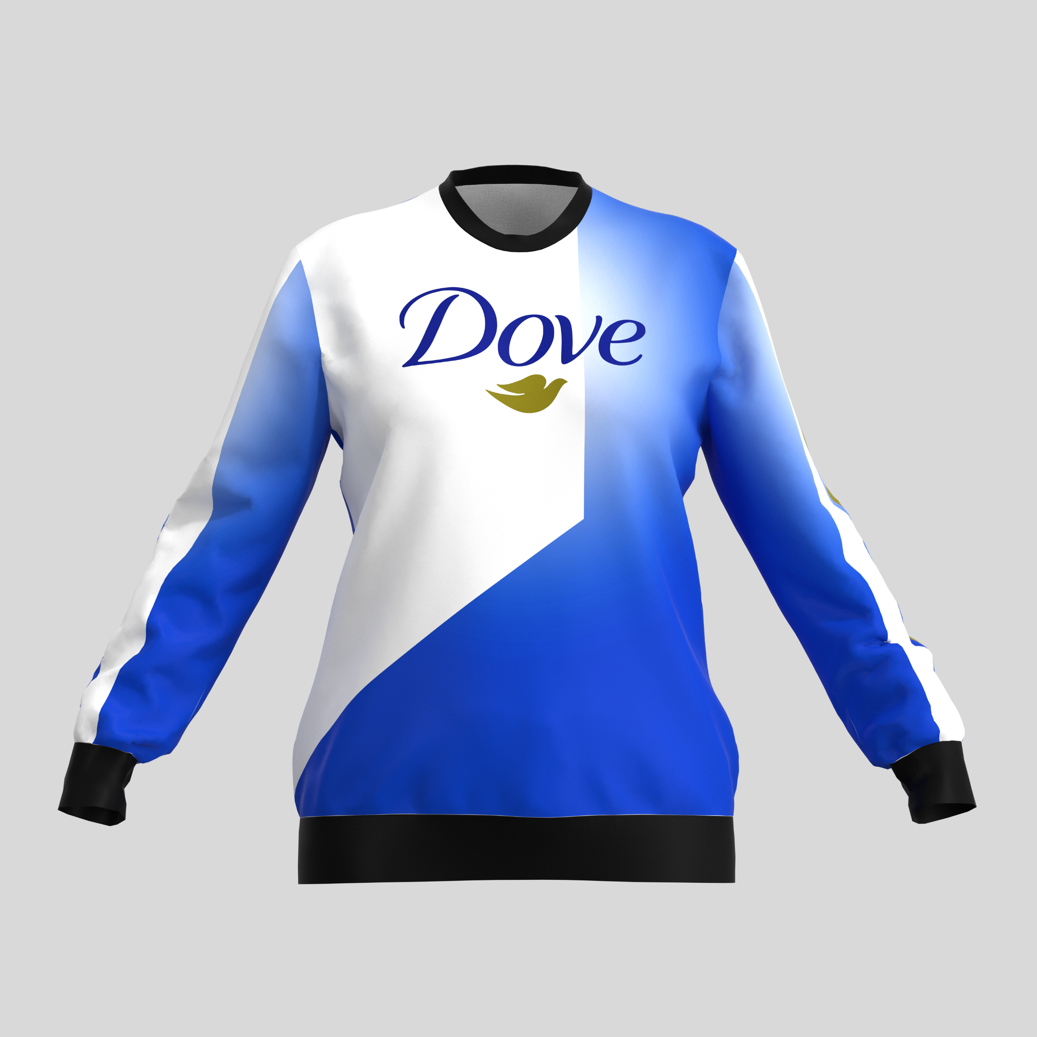
Ladies Dakota Brushed Fleece Sweater
Product Code : APP9026
Branding: Custom Design Full Colour Included in Price
Material: 240g/m2 brushed fleece
SIZES : S,M,L,XL,2XL,3XL,4XL,5XL
Price: R

Slide 4
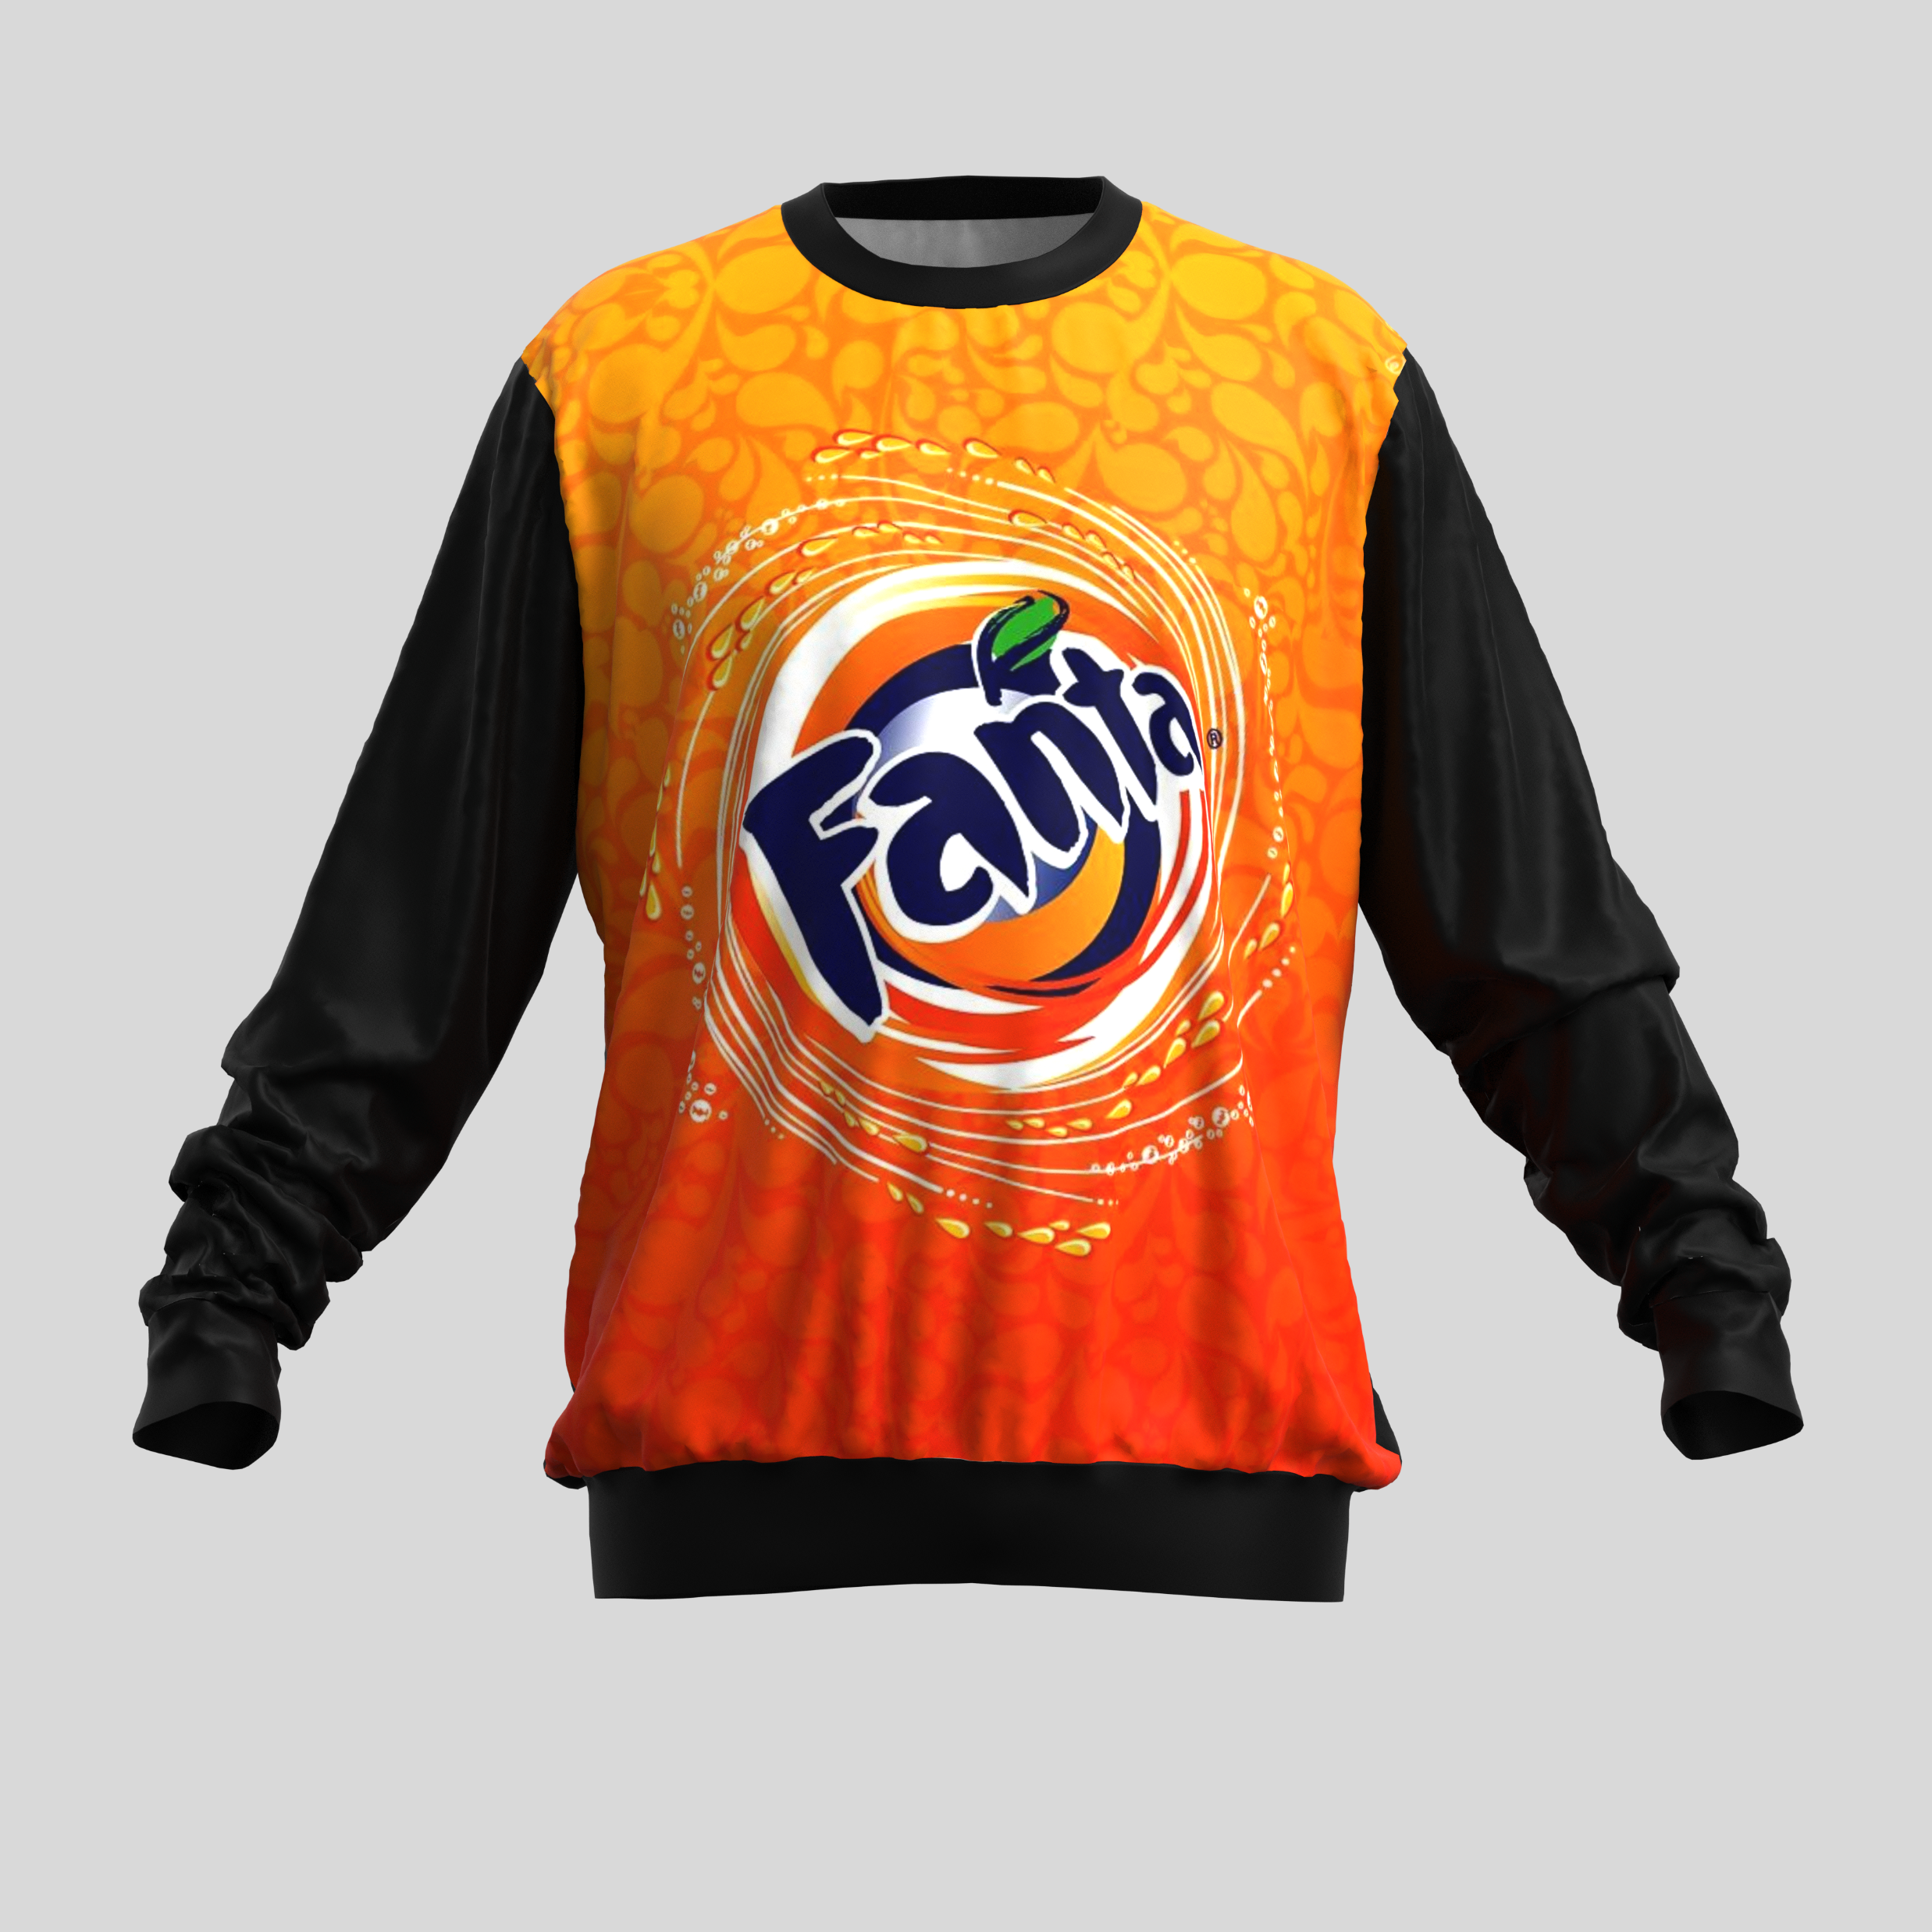
Mens Bentlee Brushed Fleece Sweater – 50/50 print on front only
Product Code : APP7047
Branding: Custom Design Full Colour Included in Price
Material: 240g/m2 brushed fleece
SIZES : S,M,L,XL,2XL,3XL,4XL,5XL
Price: R

Slide 5
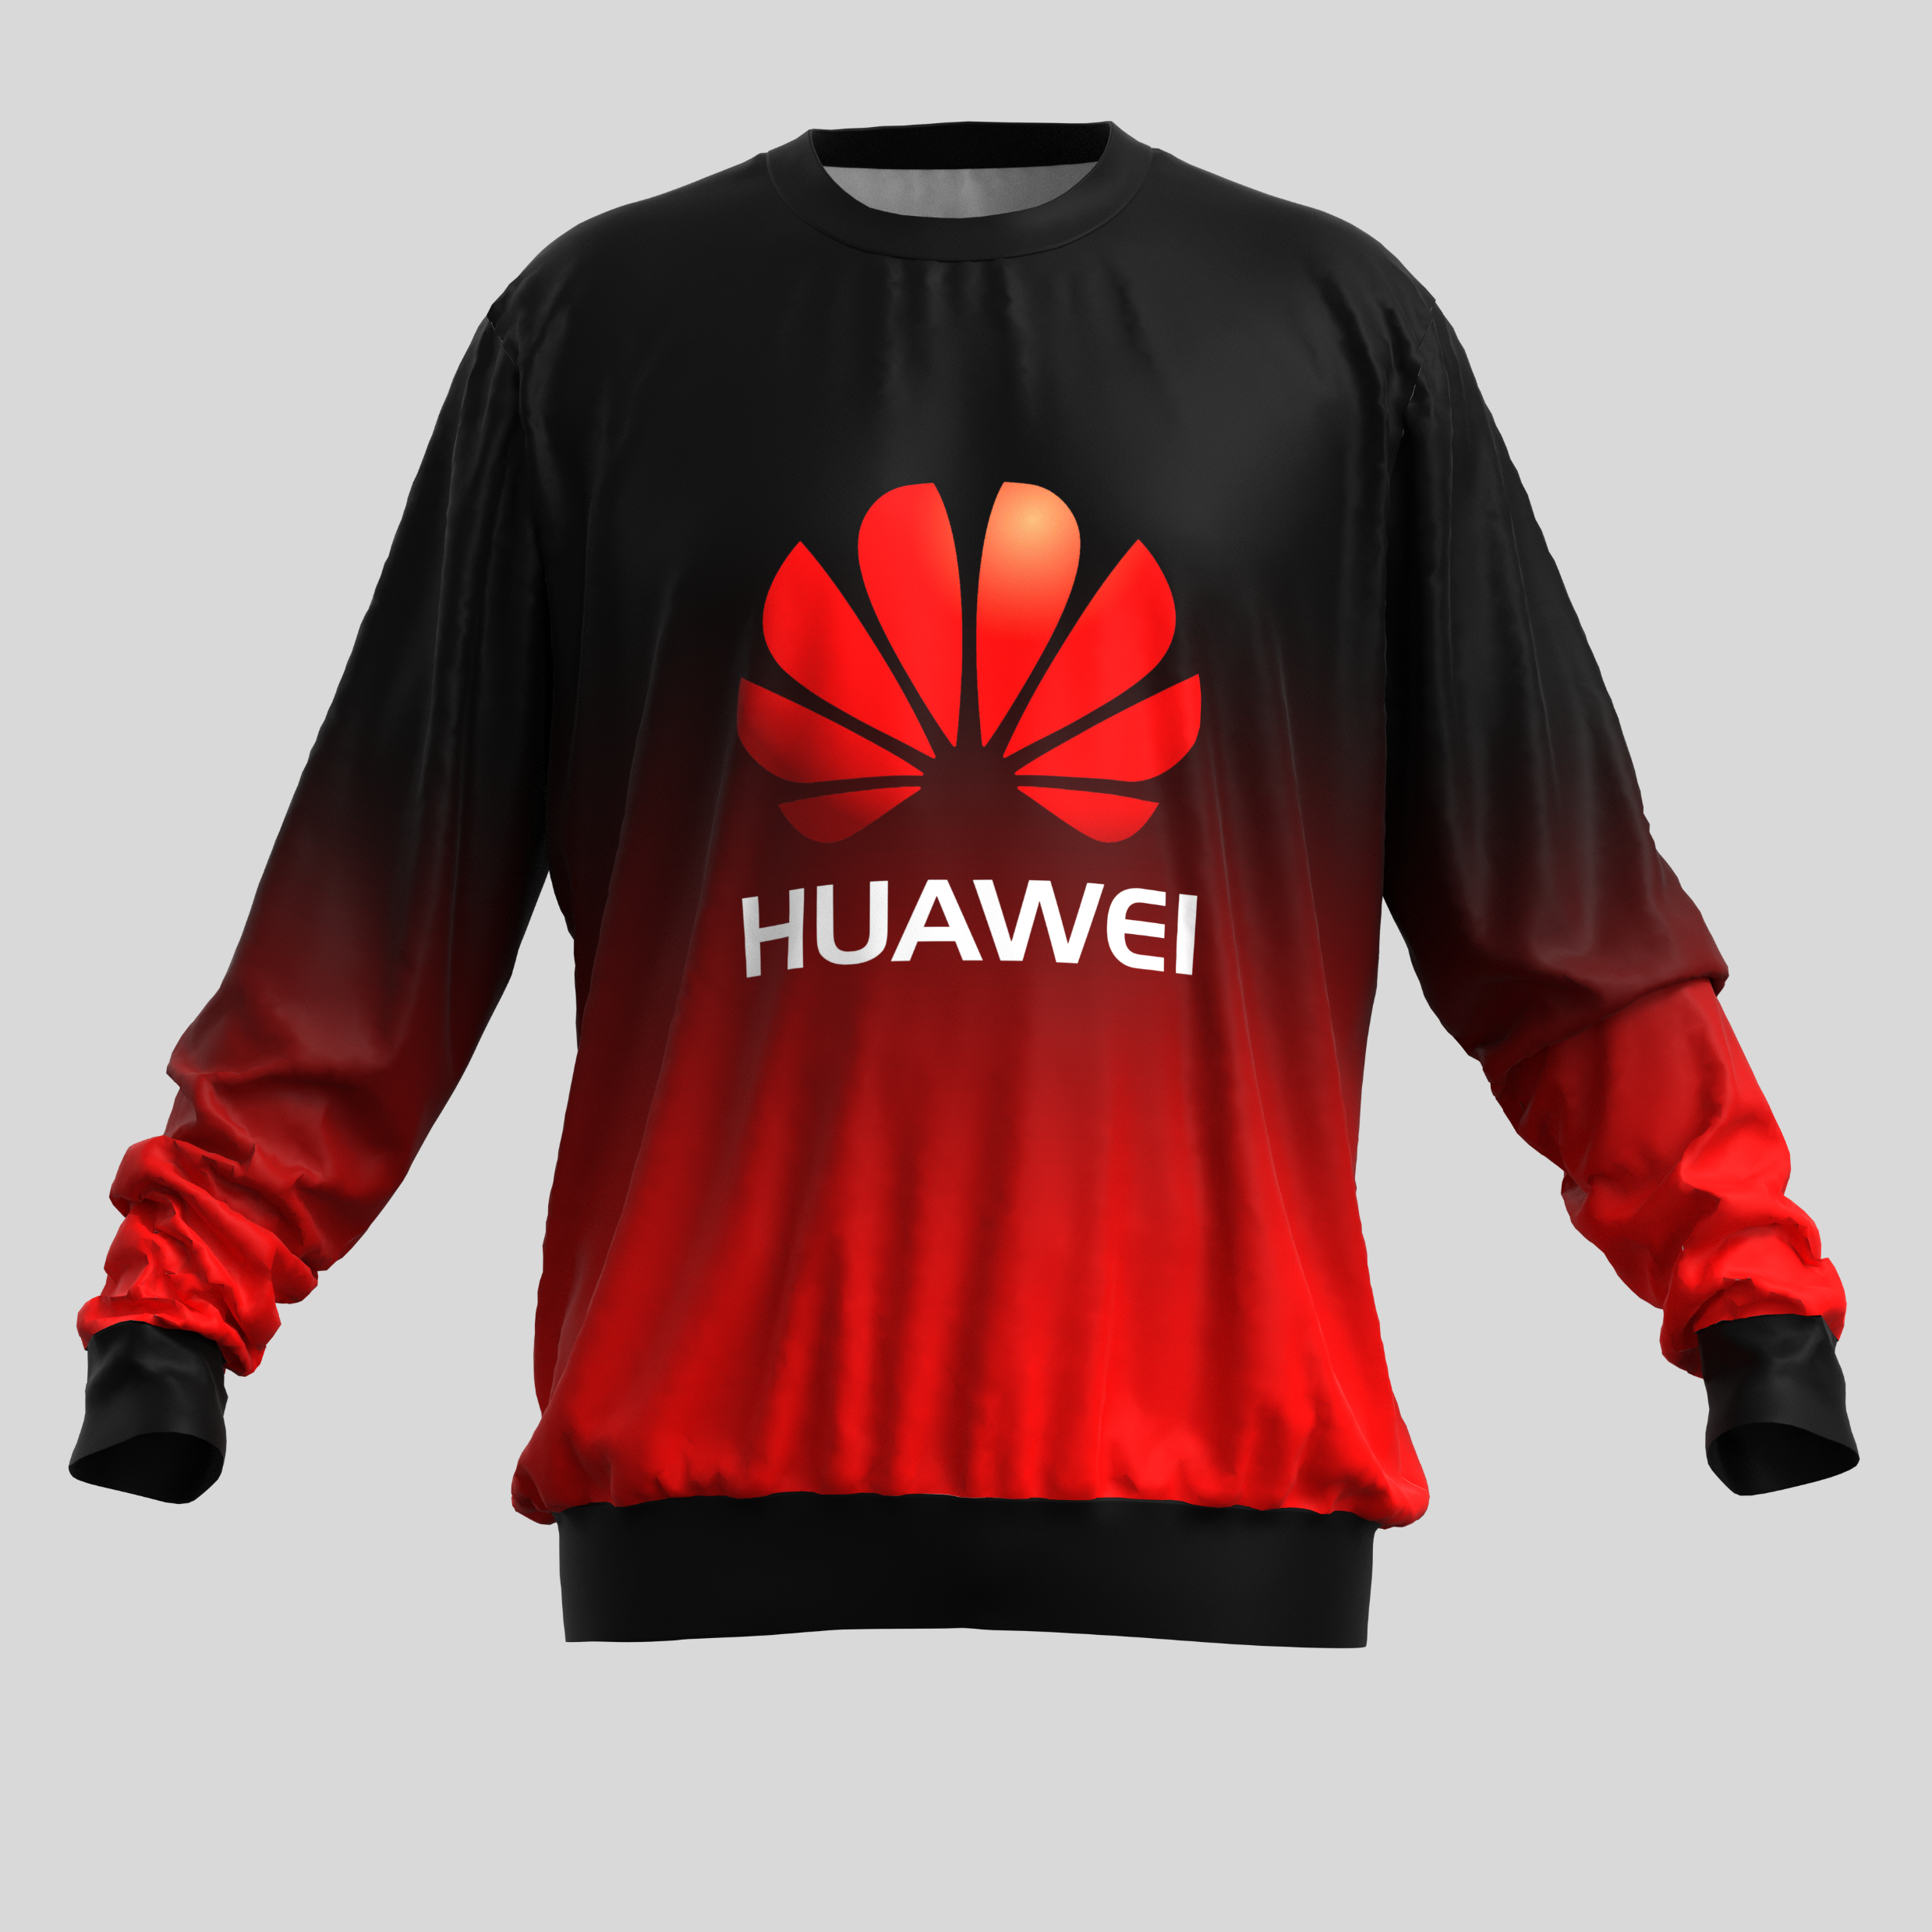
Mens Ombre Brushed Fleece Sweater
Product Code : APP331
Branding: Custom Design Full Colour Included in Price
Material: 240g/m2 brushed fleece
SIZES : S,M,L,XL,2XL,3XL,4XL,5XL
Price: R

Slide 6
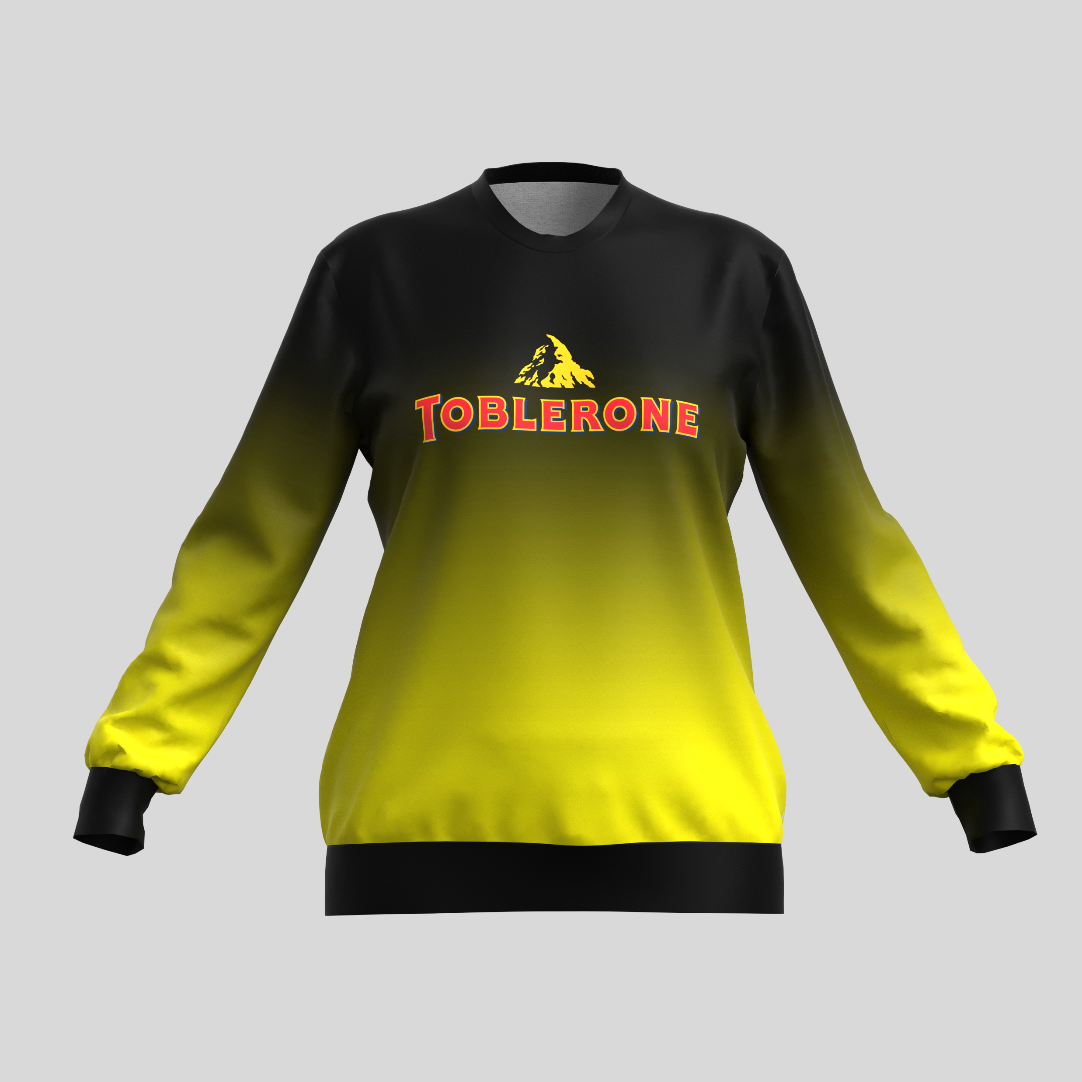
Ladies Ombre Brushed Fleece Sweater
Product Code : APP332
Branding: Custom Design Full Colour Included in Price
Material: 240g/m2 brushed fleece
SIZES : S,M,L,XL,2XL,3XL,4XL,5XL
Price: R

