Slide 1

2026 Executive
Diaries
The ultimate year-end corporate gift
As the year draws to a close, now is the perfect time to plan your year-end gifting and branding strategy. One of the most impactful and practical choices remains the promotional diary – a gift that keeps your brand in sight every single day.
Our 2025 promotional diaries are designed to combine functionality, style, and branding impact.
he ultimate year-end corporate gift

Slide 2
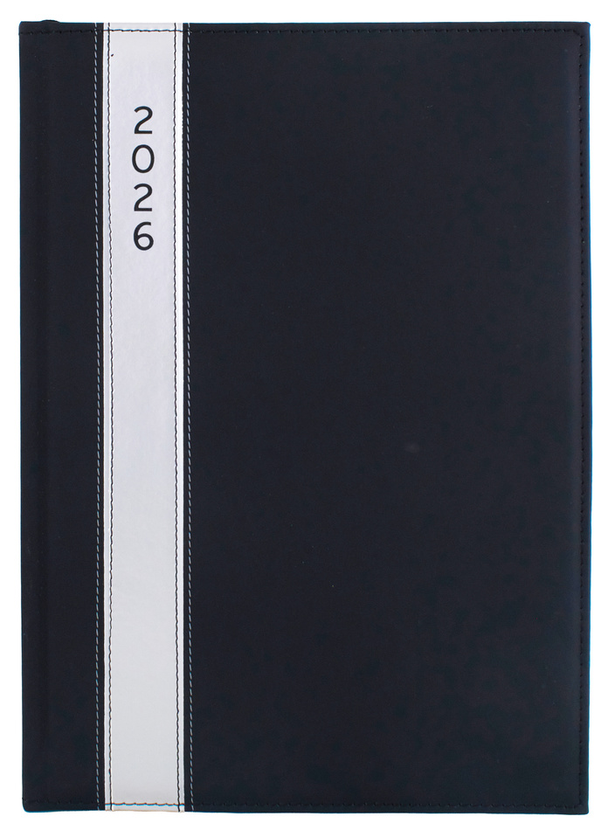
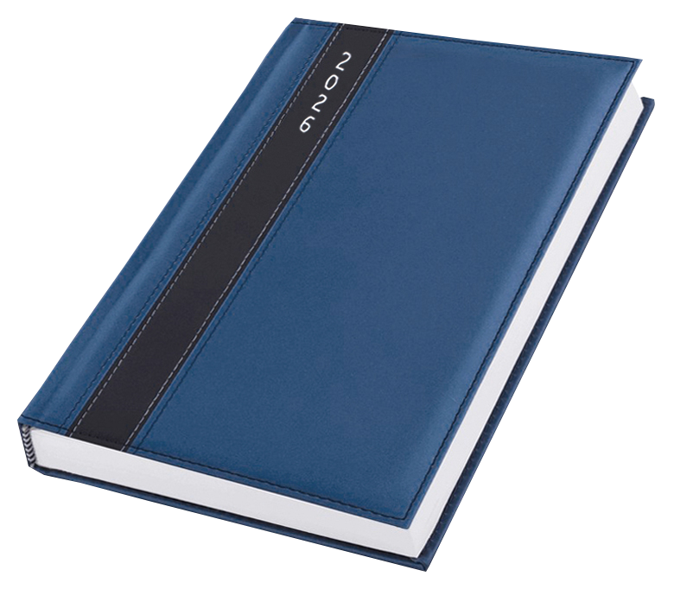
Satin A4 Diary
DIA606
Branding: Screen Print (2 colours)
Material: PU Satin
Colours: Black, Blue
MOQ: 24 units
Price: R
Daily Inspirational Quotes. Page-A-Day. With Satin Bookmark.
Inner pages include: Public Holidays, Social and Environmental Days, Holy Days & Religious Festivals, School Calendar, Africa Map, Emergency Numbers, International Dialling Codes, Web Directory, SA National Symbols, Gautrain Timetable

Slide 3
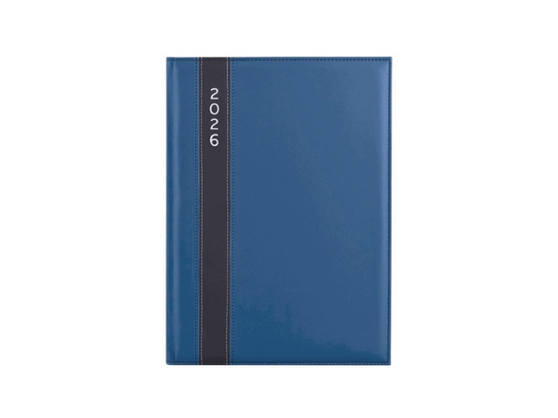
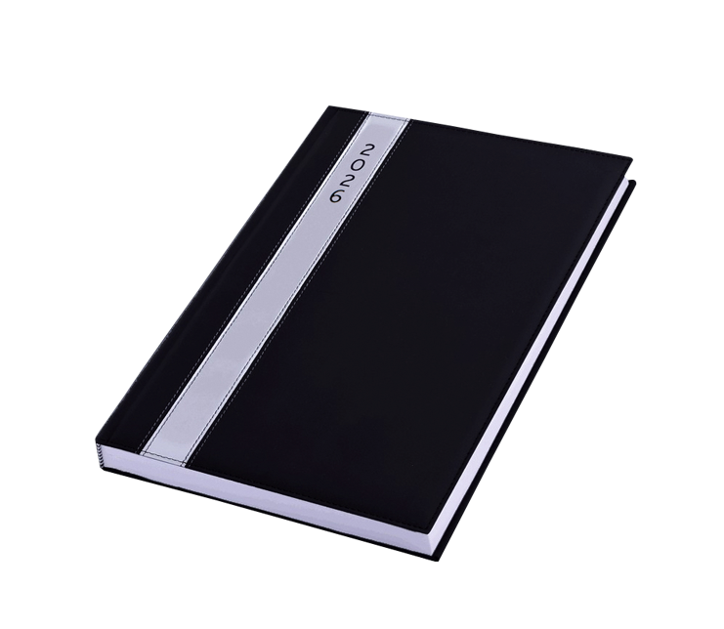
Satin A5 Diary
DIA607
Branding: Screen Print (2 colours)
Material: PU Satin
Colours: Black, Blue
MOQ: 48 units
Price: R
Daily Inspirational Quotes. Page-A-Day. With Satin Bookmark.
Inner pages include: Public Holidays, Social and Environmental Days, Holy Days & Religious Festivals, School Calendar, Africa Map, Emergency Numbers, International Dialling Codes, Web Directory, SA National Symbols, Gautrain Timetable

Slide 4
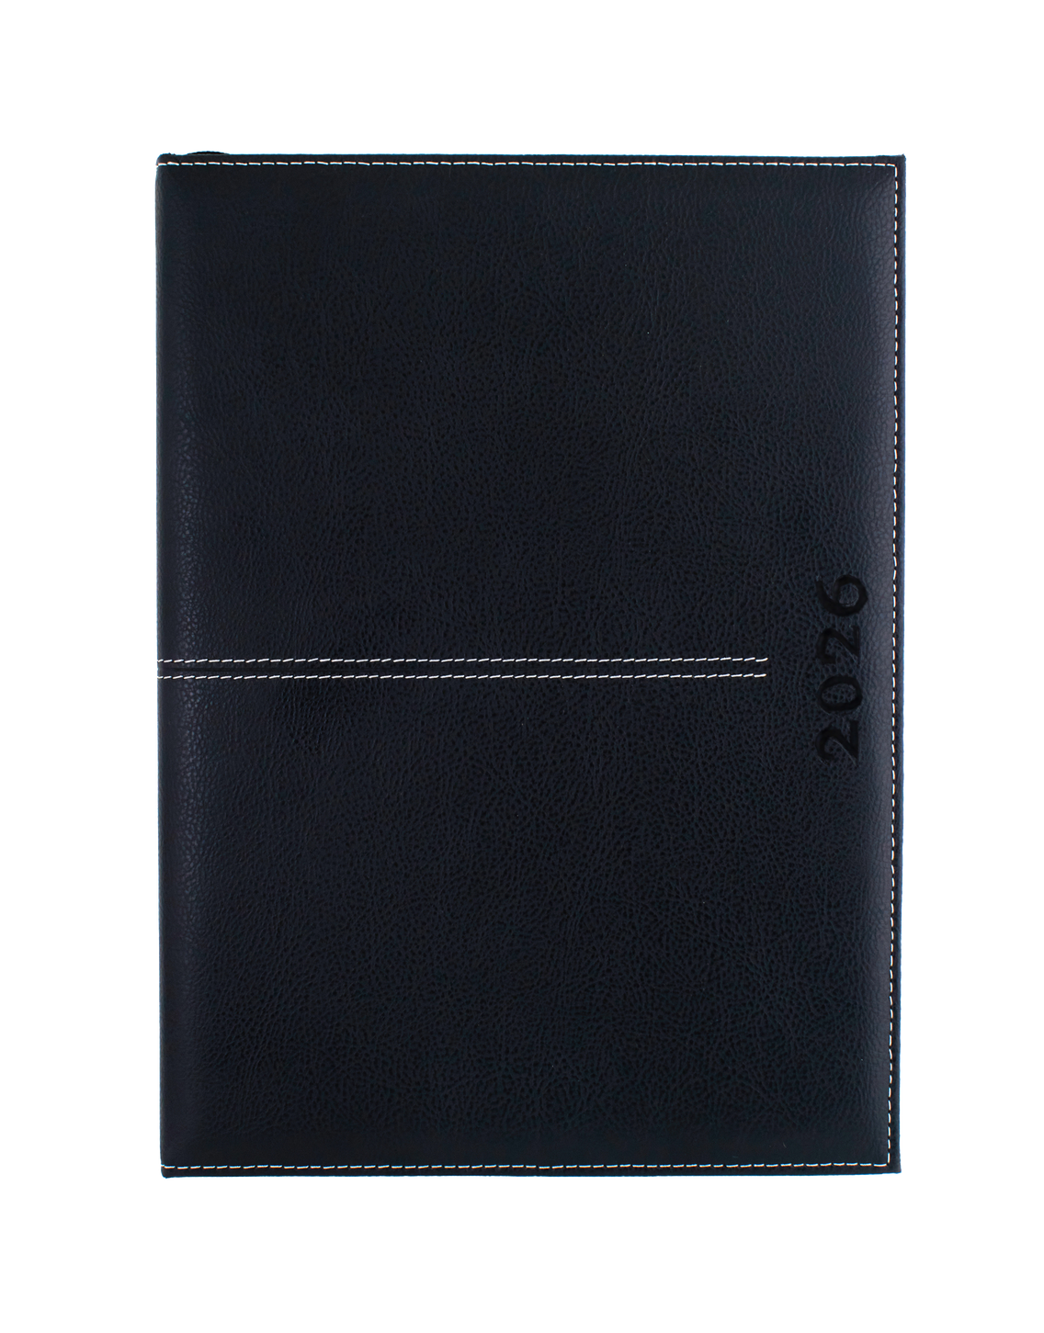
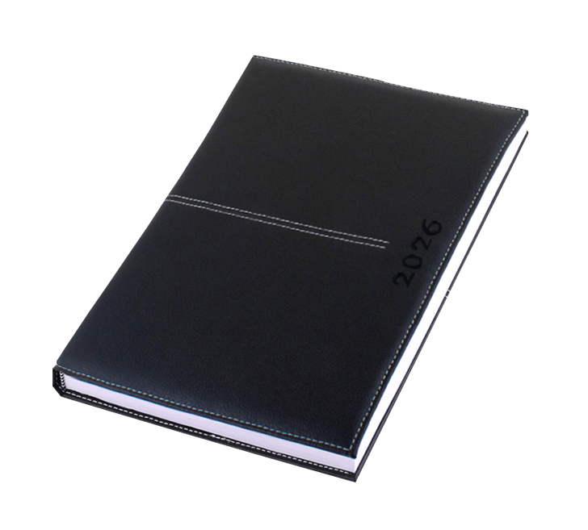
Executive A4 Diary
DIA608
Branding: Screen Print (2 colours)
Material: PU Satin
Colours: Black, Blue
MOQ: 24 units
Price: R
Daily Inspirational Quotes. Page-A-Day. With Satin Bookmark.
Inner pages Include: Public Holidays, Social and Environmental Days, Holy Days & Religious Festivals, School Calendar, Africa Map, Emergency Numbers, International Dialling Codes, Web Directory, SA National Symbols, Gautrain Timetable

Slide 5
Executive A5 Diary
DIA609
Branding: Screen Print (2 colours)
Material: PU Satin
Colours: Black, Blue
MOQ: 48 units
Price: R
Daily Inspirational Quotes. Page-A-Day. With Satin Bookmark.
Inner pages Include: Public Holidays, Social and Environmental Days, Holy Days & Religious Festivals, School Calendar, Africa Map, Emergency Numbers, International Dialling Codes, Web Directory, SA National Symbols, Gautrain Timetable

Slide 6

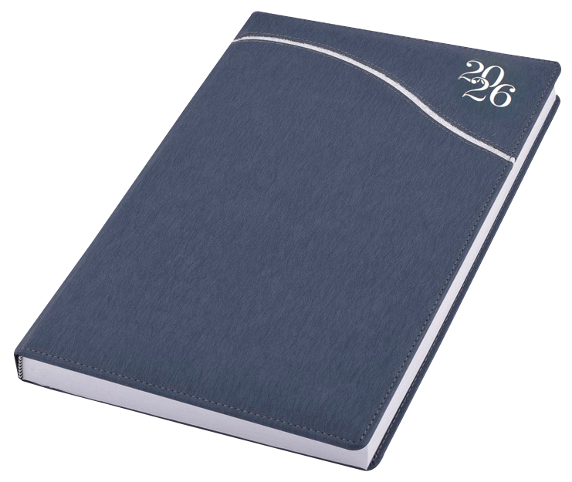
Streamline A4 Diary
DIA616
Branding: Screen Print (2 colours)
Material: Koskin with white stitching
Colours: Blue, Grey
MOQ: 24 units
Price: R
Daily Inspirational Quotes. Page-A-Day. With Satin Bookmark.
Inner pages Include: Public Holidays, Social and Environmental Days, Holy Days & Religious Festivals, School Calendar, Africa Map, Emergency Numbers, International Dialling Codes, Web Directory, SA National Symbols, Gautrain Timetable

Slide 7

Streamline A5 Diary
DIA615
Branding: Screen Print (2 colours)
Material: Koskin with white stitching
Colours: Blue, Grey
MOQ: 48 units
Price: R
Daily Inspirational Quotes. Page-A-Day. With Satin Bookmark.
Inner pages Include: Public Holidays, Social and Environmental Days, Holy Days & Religious Festivals, School Calendar, Africa Map, Emergency Numbers, International Dialling Codes, Web Directory, SA National Symbols, Gautrain Timetable

Slide 8
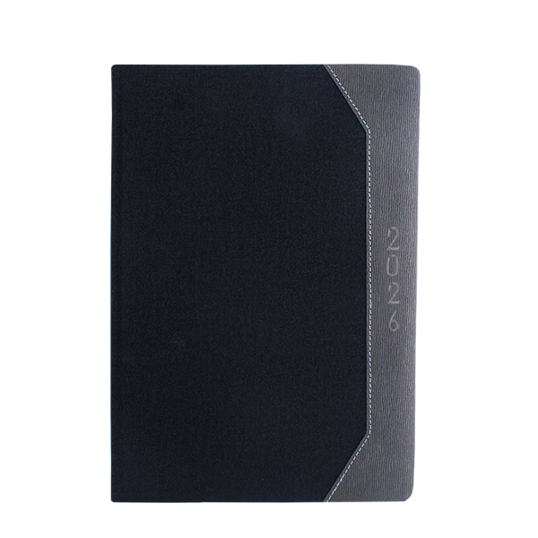

Ode A4 Diary
DIA620
Branding: Screen Print 2 colours)
Material: Koskin with white stitching
Colours: Black
MOQ to order: 24 units
Price: R
Daily Inspirational Quotes. Page-A-Day. With Satin Bookmark.
Inner pages Include: Public Holidays, Social and Environmental Days, Holy Days & Religious Festivals, School Calendar, Africa Map, Emergency Numbers, International Dialling Codes, Web Directory, SA National Symbols, Gautrain Timetable

Slide 9
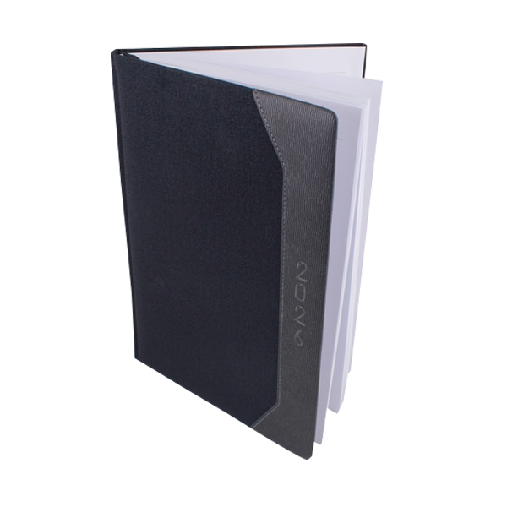
Eck A5 Diary
DIA621
Branding: Screen Print 2 colours)
Material: Koskin with white stitching
Colours: Black
MOQ to order: 48 units
Price: R
Daily Inspirational Quotes. Page-A-Day. With Satin Bookmark.
Inner pages Include: Public Holidays, Social and Environmental Days, Holy Days & Religious Festivals, School Calendar, Africa Map, Emergency Numbers, International Dialling Codes, Web Directory, SA National Symbols, Gautrain Timetable

